Slide 1

Nebraska Volleyball
How to Build Championship Teams
Brian Kmitta II
Director of Olympic Strength & Conditioning
University of Nebraska

Slide 2

Husker Power Principles
1. Multi-Joint Movements
2. Ground-Based Activities
3. Three-Dimensional Activities
4. Explosive Training
5. Progressive Overload
6. Seasonal Application
7. Split Program
8. Heavy-Light System
9. Interval Training
10. Correct Energy System

Slide 3
Principles of Training
Specificity
Periodization
Progressive Overload
Train the Force-Velocity Curve

Slide 4
Specificity
Train what you want to improve
Train adaptations are specific to the stimulus applied
For team sports this means the training must mimic the demands of the sport

Slide 5
Specificity Method
Strength- Muscle Actions, Gound-Based Actions, Multiple-Joint Actions
Speed-Maximal intensity
Agility/COD- Movement Patterns
Jumps/Plyo- Force Vectors
Conditioning- Energy System Demands

Slide 6
Periodization
Potentiate Effect of Phase-Based Training
Systematic planning of training over time to maximize performance at key times
Minimizing injury risk and burnout

Slide 7
Periodization Methods
Strength- Develop physical qualities in the right order
Speed- Like strength speed is build with phases
Agility/COD- Develop both mechanics and reactivity
Jumps/Plyo- Low intensity to High intensity
Conditioning- Should complement each training phases

Slide 8
Progressive Overload
Systematically increasing intensity, volume, or complexity
The body adapts to stress over time, stimulate need to increased to stimulate new adaptation and improve performance

Slide 9
Progressive Overload Methods
Strength- Heavy-Light System
Speed- Short to Long
Agility/COD- Simple to Complex
Jumps/Plyo- Low level Rhythmic to High power output
Conditioning- Low volume to high output repeat effort sprints

Slide 10
Train the Force-Velocity Curve
Developing an athlete’s ability to produce force at various speeds
Describes the inverse relationship between force and velocity during muscular contraction

Slide 11
Force-Velocity Curve Methods
Strength- Train Explosively
Speed- Resisted Sprint Training
Agility/COD- Requires both braking forces and explosive re-acceleration
Jumps/Plyo- Training that targets both force and velocity
Conditioning- Its not just about fatigue, its about repeated high force output efforts also

Slide 12
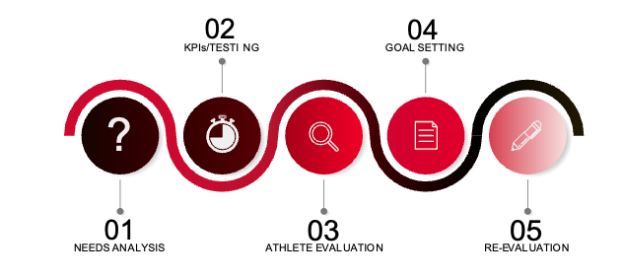
Assessment and
Evaluation

Slide 13
Needs Analysis
A systematic assessment to identify the specific demands, risks, and goals of teams

Slide 14
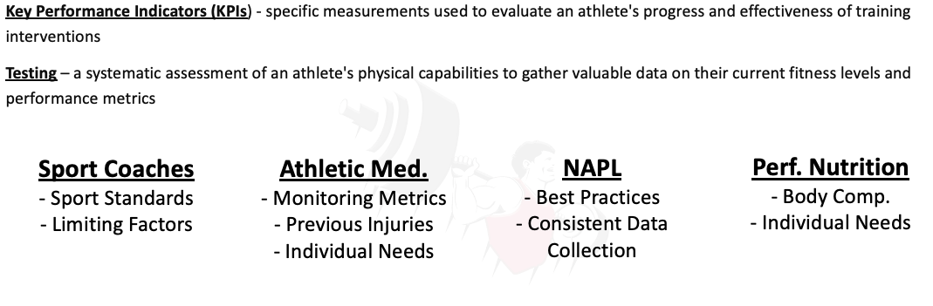
KPI’s/Testing

Slide 15
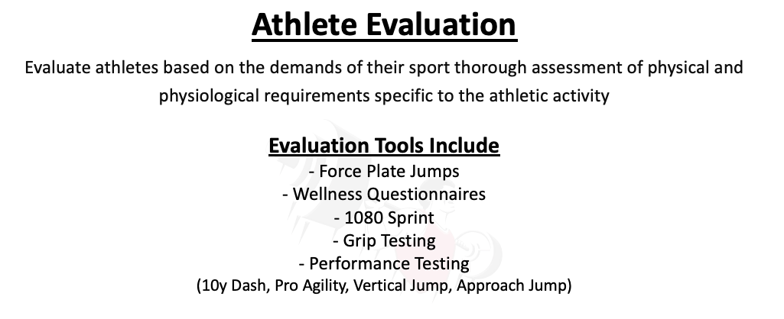
KPI’s/Testing

Slide 16
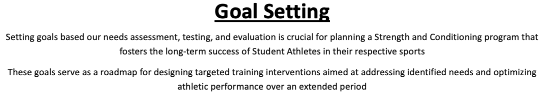
Goal Setting

Slide 17
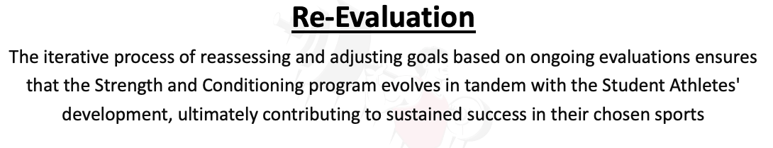
Repeat Four Step Evaluation Process
››››››

Slide 18
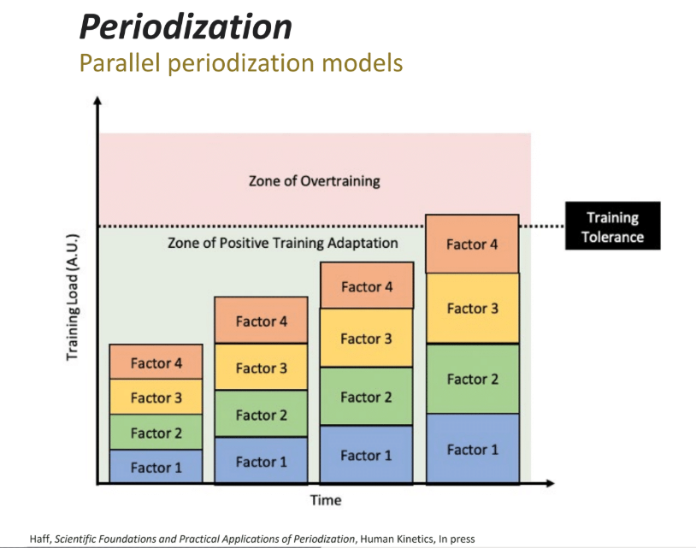
Plan the work. Work the plan.
››››››

Slide 19
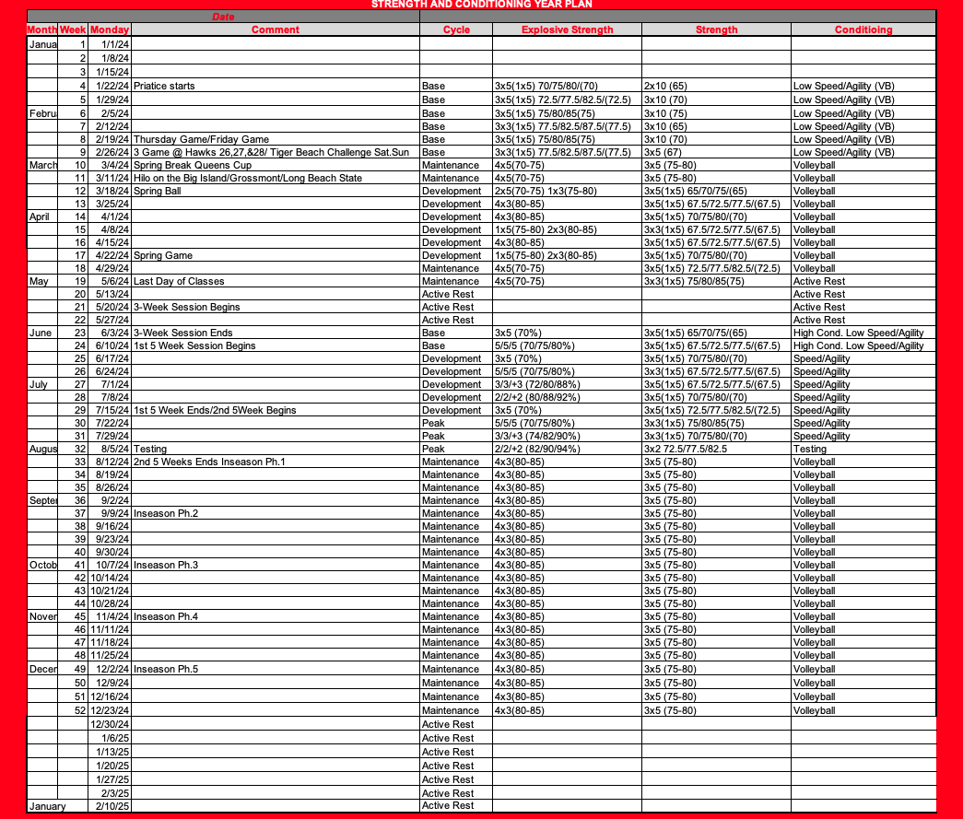
Year Plan

Slide 20
Training Frequency

Slide 21
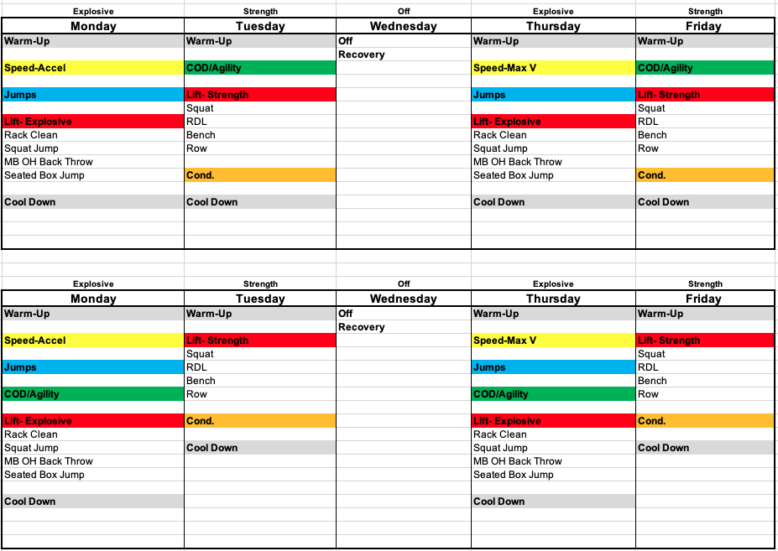
Weekly Outline

Slide 22
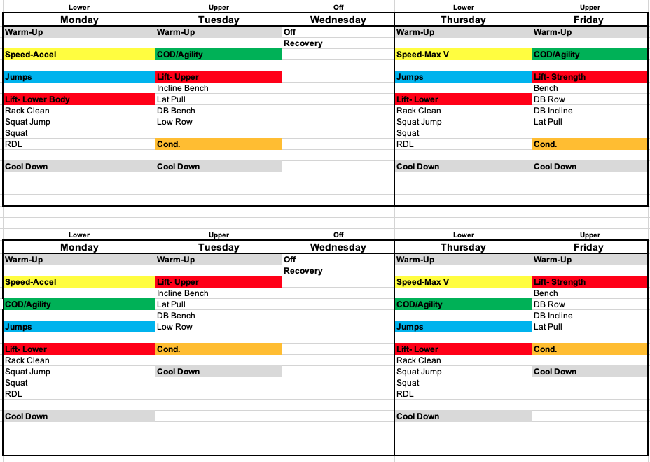
Weekly Outline

Slide 23
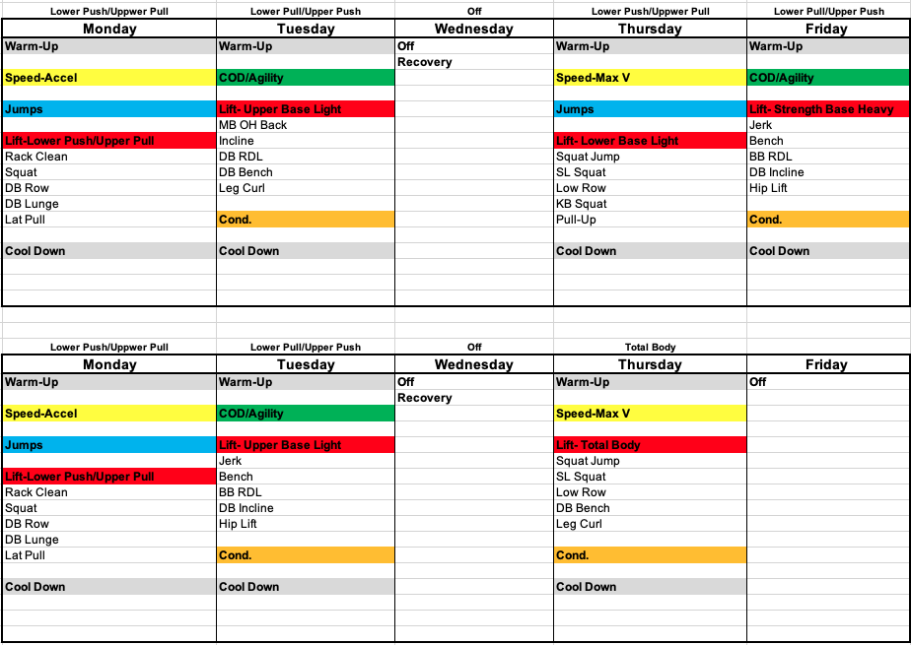
Weekly Outline

Slide 24
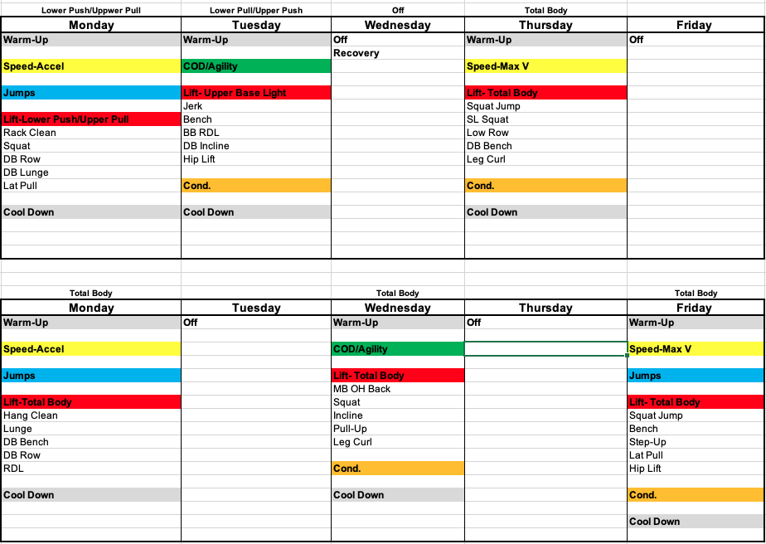
Weekly Outline

Slide 25
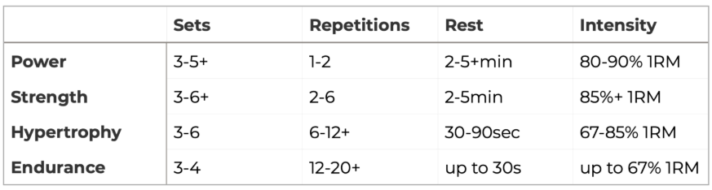
Training Load and Repetitions

Slide 26
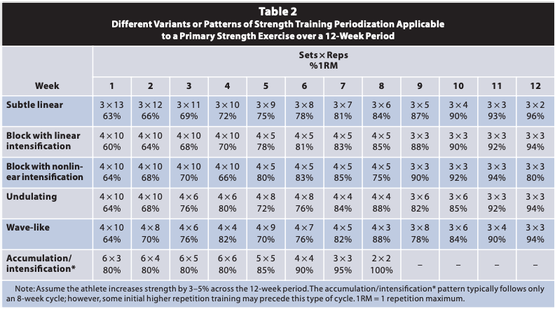
Daniel Baker S&C Journal 2007

Slide 27
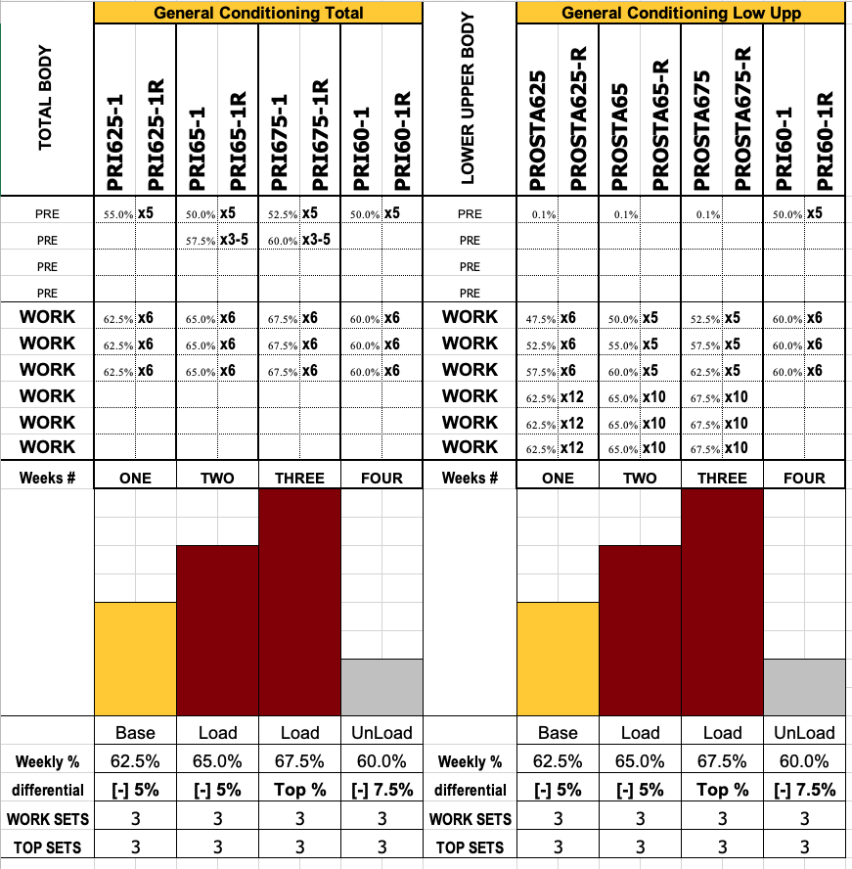
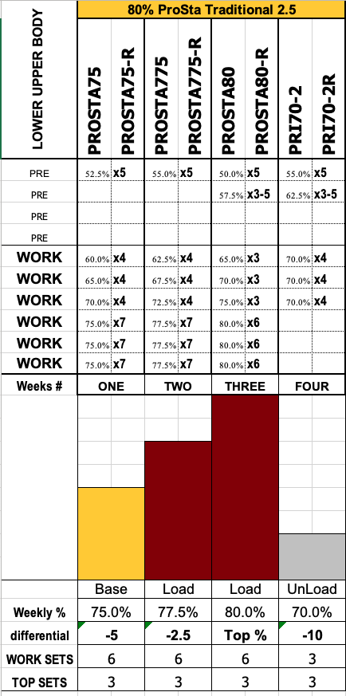
Joe Kenn Strength Playbook

Slide 28
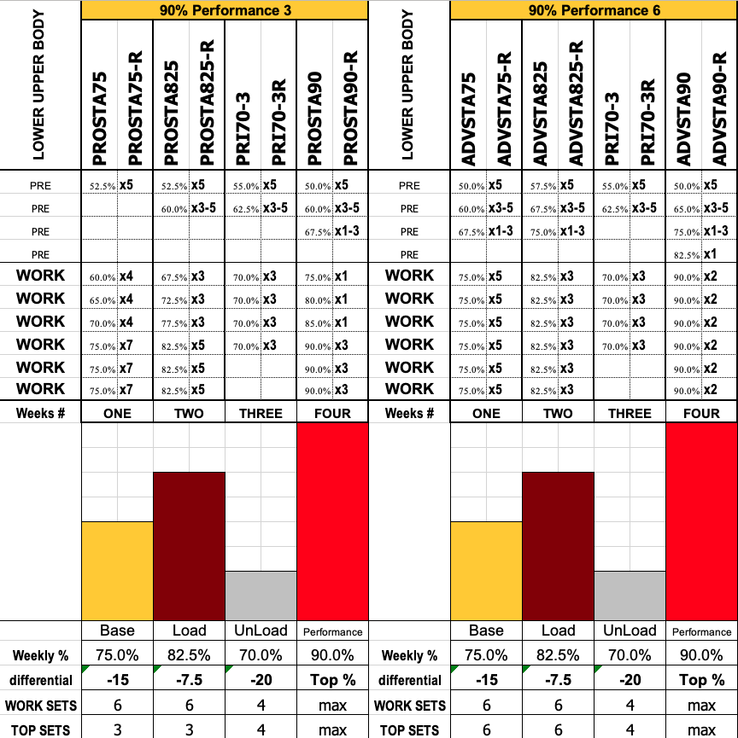
Joe Kenn Strength Playbook

Slide 29
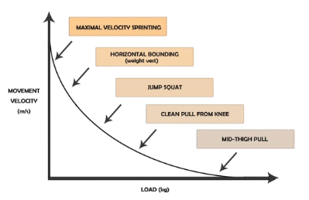
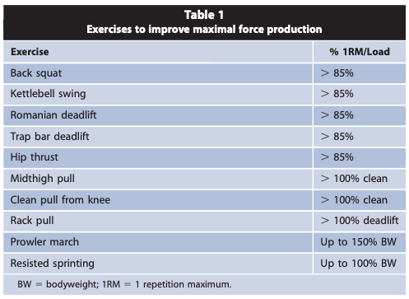
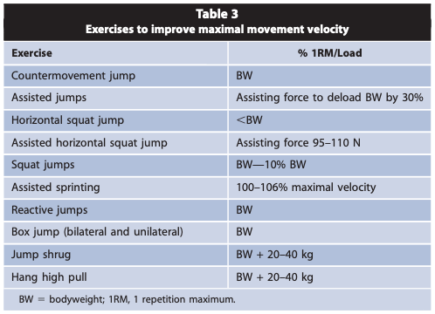
Exercise Selection Morin S&C Journal 2020

Slide 30
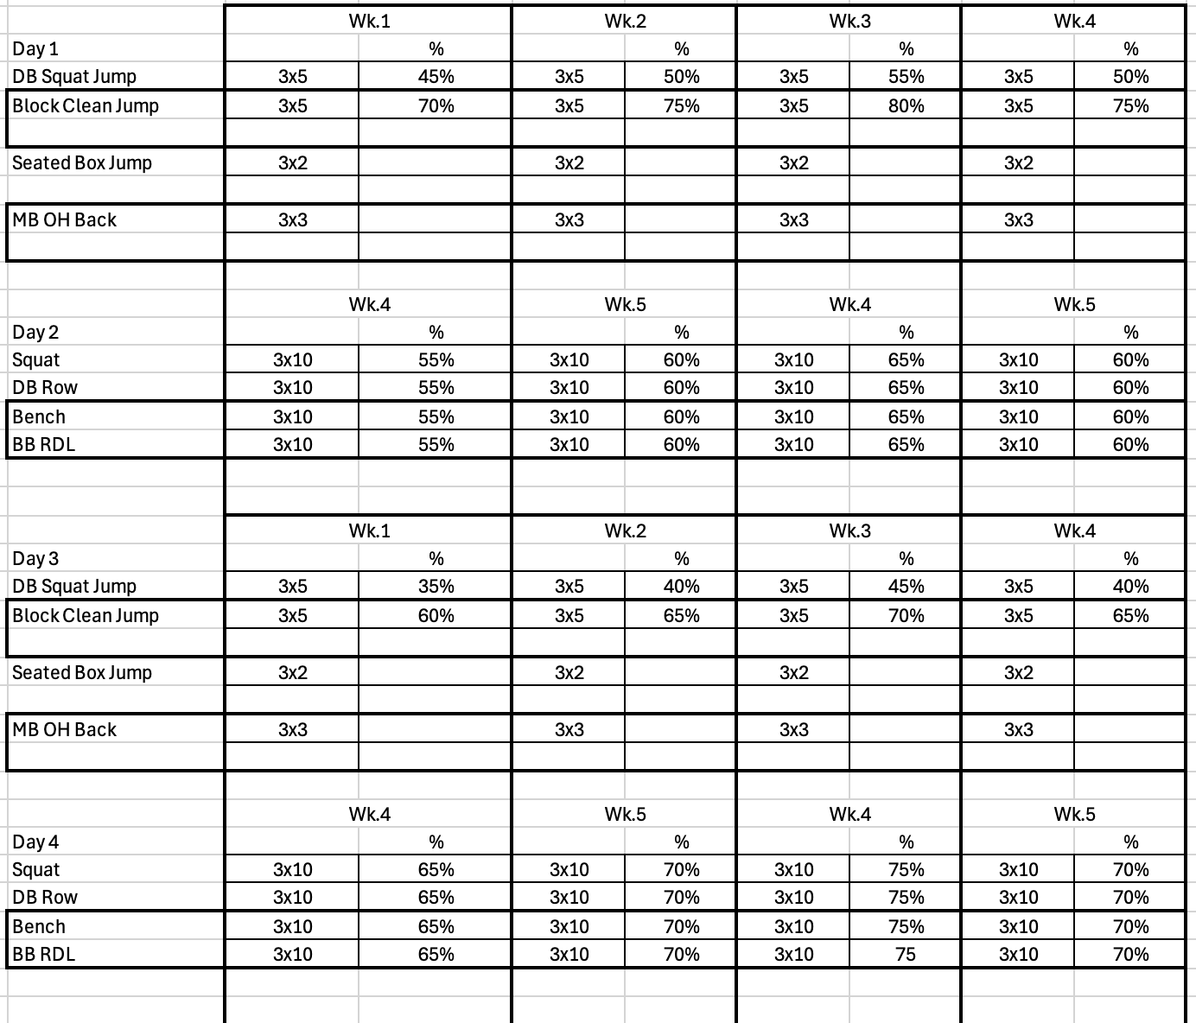
Base

Slide 31
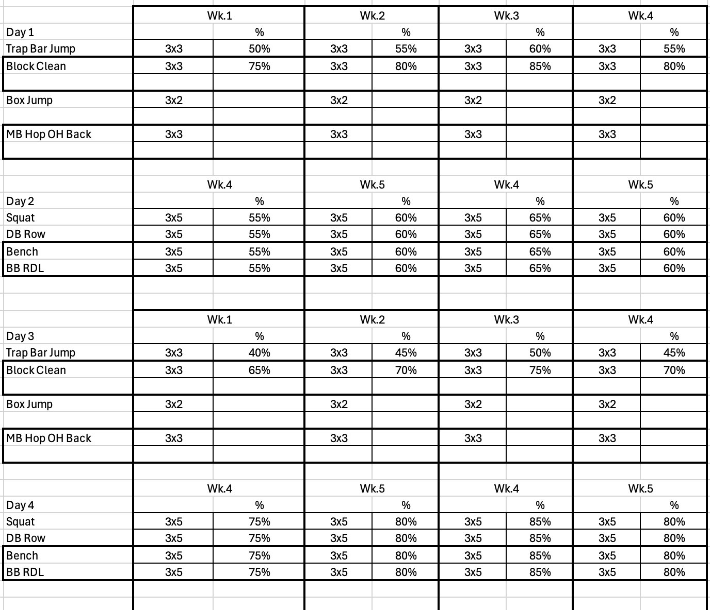
Development

Slide 32
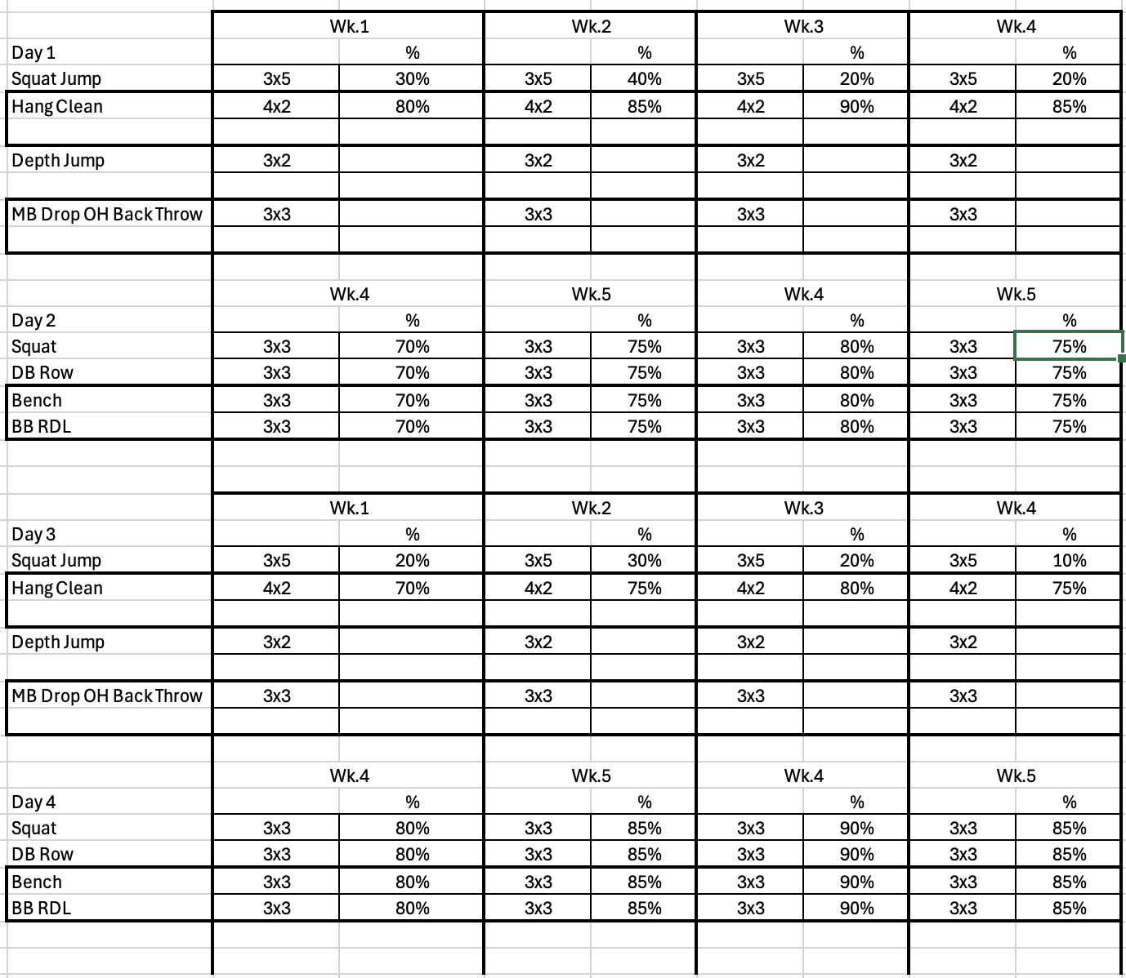
Peak

Slide 33
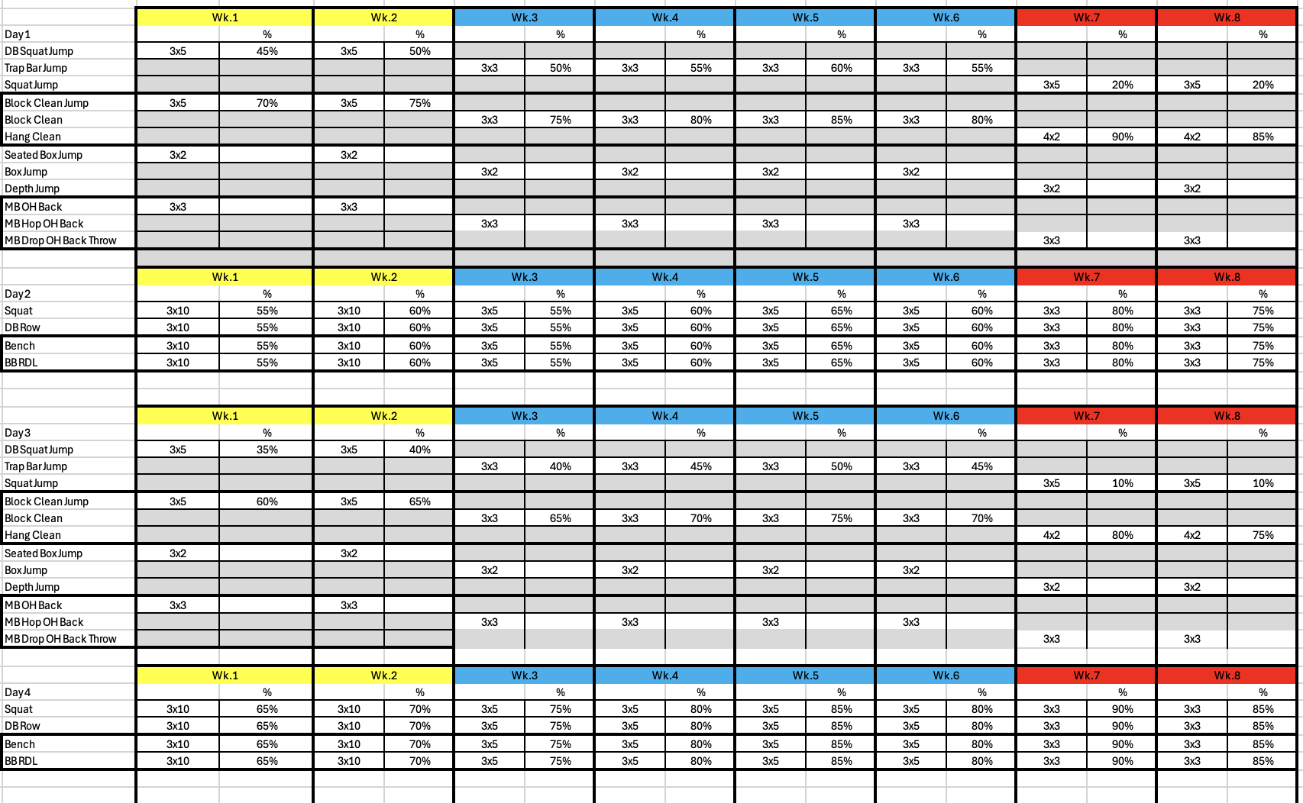
8 Week

Slide 34
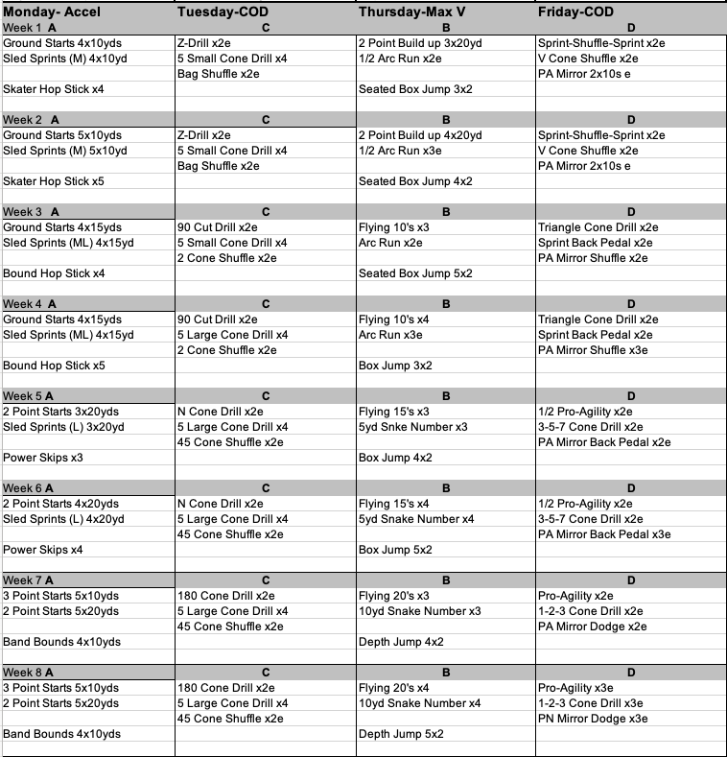
Speed &
COD

Slide 35
Thank You

