Slide 1

Speed, Agility, & COD
Training for Team Sports
Brian Kmitta II
Director of Olympic Sports Performance
University of Nebraska

Slide 2
Objectives
*Define Speed, Agility and COD
*Discuss differences between linear speed and COD/Agility
*Explain key training principles
*Provide drills, programming tips, and training examples

Slide 3
What is speed?

Slide 4

Linear Speed
The skills and abilities needed to achieve high movement velocities.
Usually quantified by time or yards per sec.

Slide 5
Sprinting
Acceleration Training (0-30yds)
Max Velocity (>30yds)

Slide 6
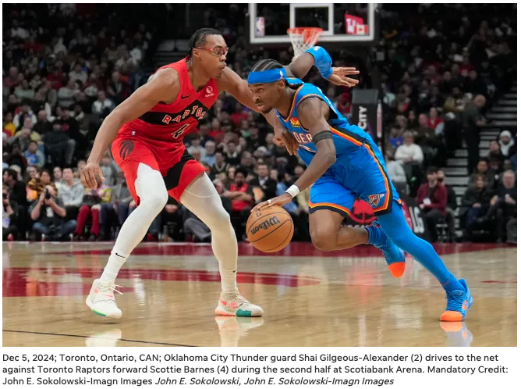
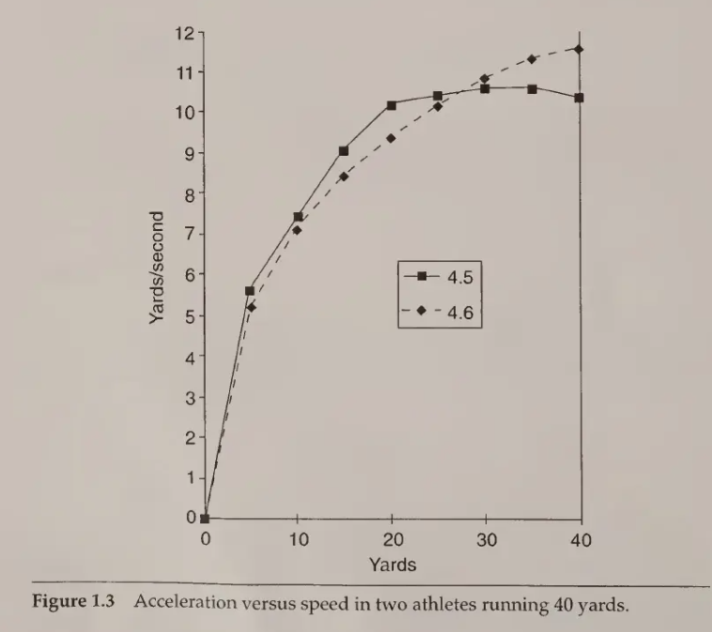
Acceleration

Slide 7
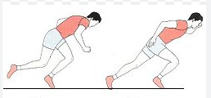
Acceleration
Horizontal Force
Center of mass in front of base of support
Long ground contact times
Large joint angles
Low flight times
Short stride length
Low stride frequency

Slide 8
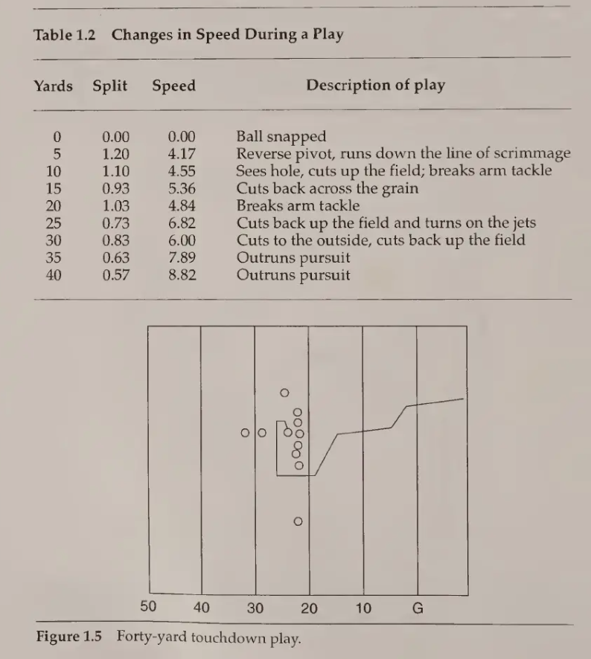

Max Velocity

Slide 9
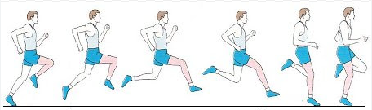
Max Velocity
Vertical force
Center of mass over base or support
Short ground contact time
Small joint angle
High flight times
Long stride length
High stride frequency

Slide 10
What is Change of Direction?

Slide 11
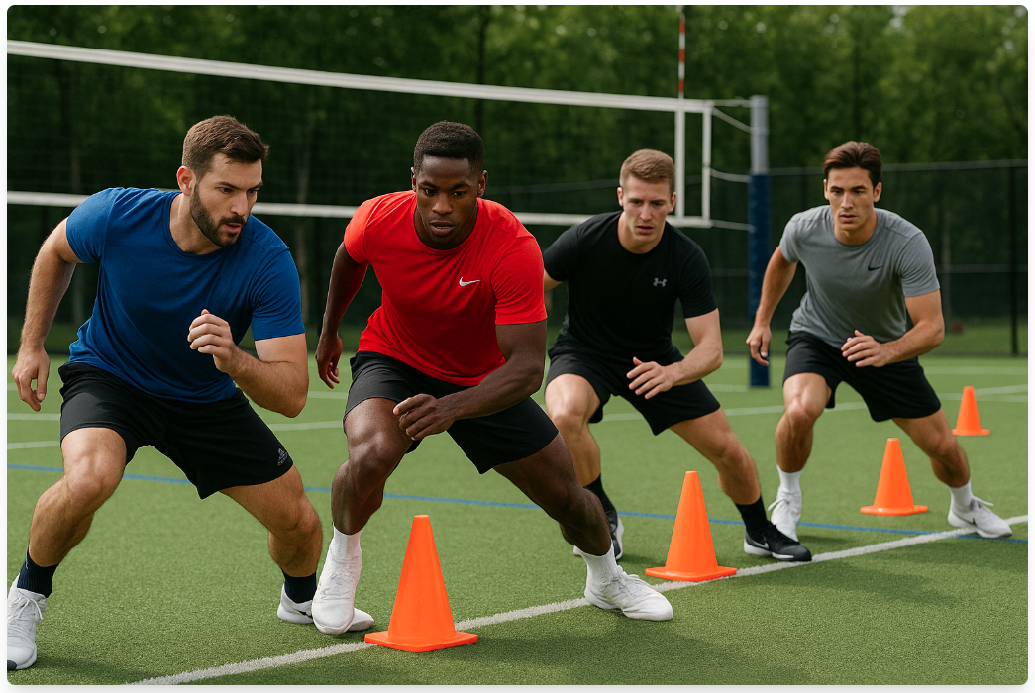
Change of direction (COD)
The skills and abilities needed to explosively change movement direction, velocities, or modes.

Slide 12
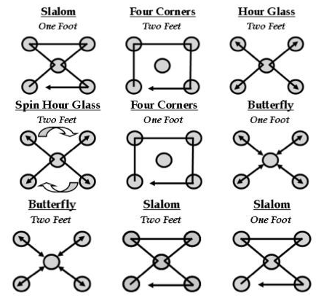
Change of direction (COD)
Pre-Planned
Focus Mechanics
Cone Based Drill

Slide 13
COD Training
Simple to Complex
Lower-Intensity drills to Higher-Intensity drills
Closed Drills to Open Drills

Slide 14
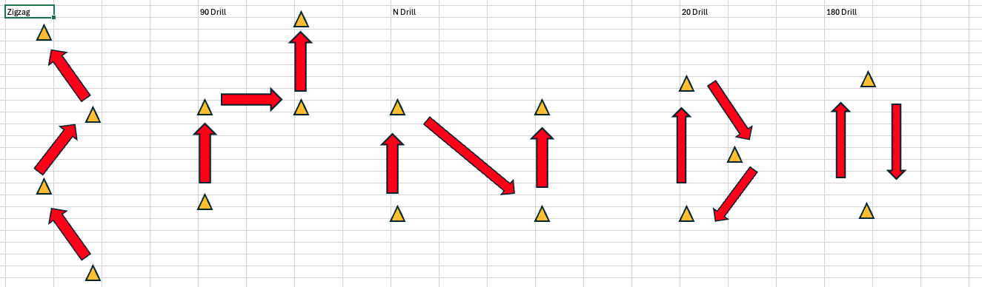
Angle-Velocity and Progressive Overload

Slide 15
What is Agility?

Slide 16
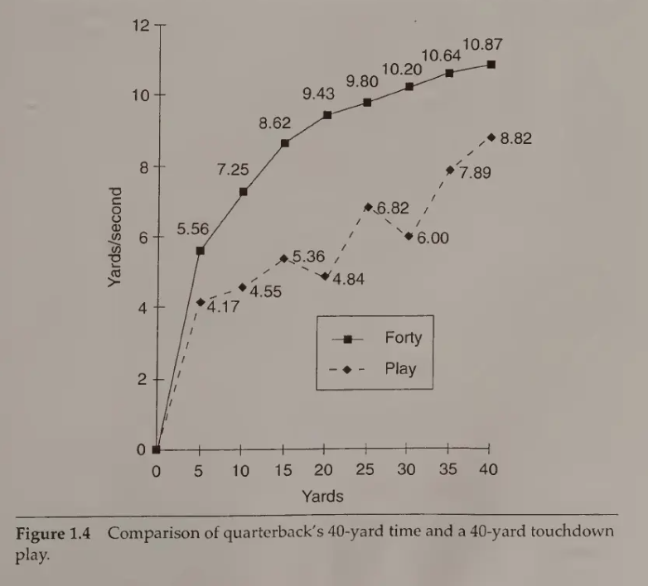
Agility
The skills and abilities needed to change direction, velocity, or mode in a response to a stimulus.

Slide 17
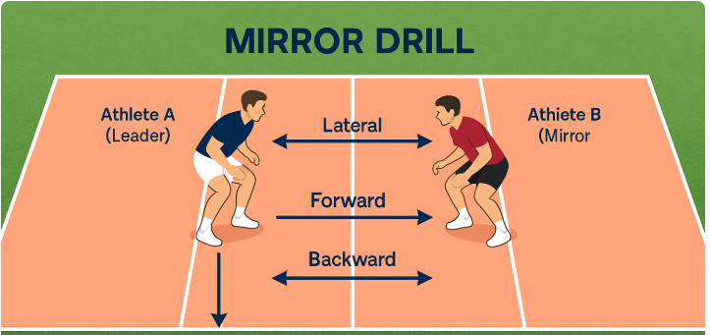
Agility
Reactive
Focus on Perception/Action
Open Drills to Game Like

Slide 18
Agility Training
Slow to Fast
Simple to Complex
Predictable to Unpredictable

Slide 19
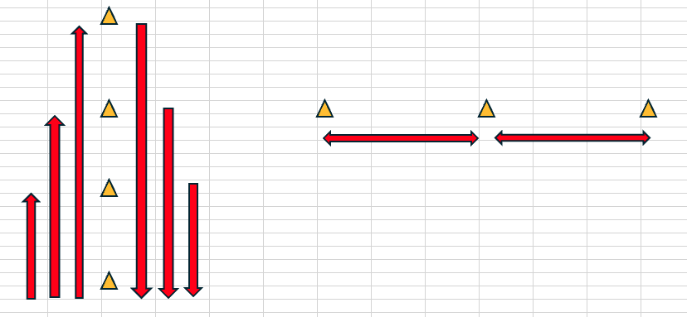
Progressive Overload & Predictable to Unpredictable

Slide 20
Why You Should Train Speed
*Speed Development
*Strength Development
*Reduce Risk of Soft Tissue Injury
*Motor Learning

Slide 21
Types of Speed Training

Slide 22
Sport-Specific Movement Types
Evasion: Rapid, large-angle directional change to avoid an opponent or create separation

Slide 23
Sport-Specific Movement Types
Subtle Change of Direction: Small to moderate direction shifts made while maintaining movement rhythm and positioning

Slide 24
Sport-Specific Movement Types
Velocity Maintenance: Continuation of sprinting while navigating small directional adjustments without reducing speed

Slide 25
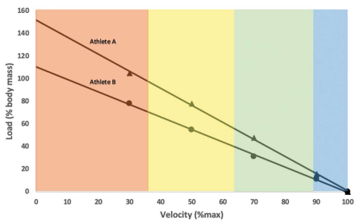
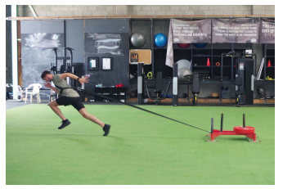
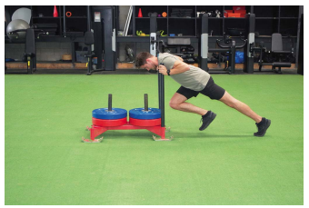
Resisted Sprint Training
Sled Push, Band/Sled Towing, Weight Vest, Hill/Stadium, and Running into the Wind

Slide 26
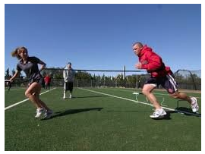
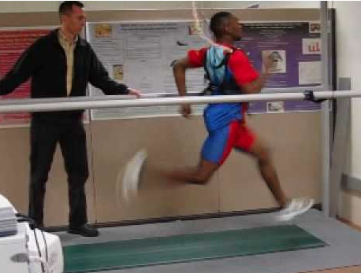
Assisted Sprint Training
Band/Cord, Towing Systems, High-Speed Treadmills, Downhill, and Running with the Wind

Slide 27
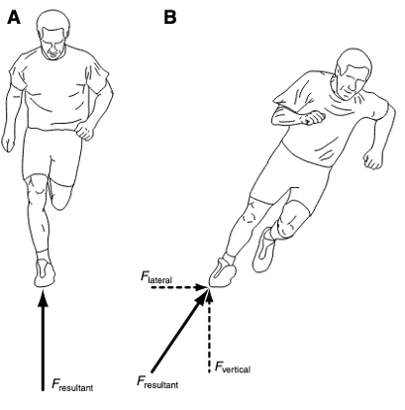
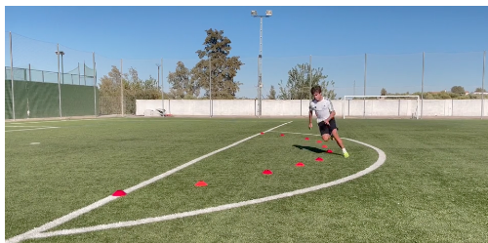
Curvilinear Sprinting
Sprinting along a curved or arcing path

Slide 28
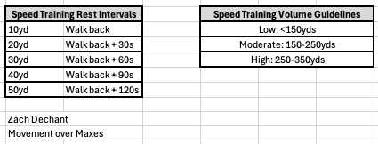
Speed vs. Conditioning

Slide 29
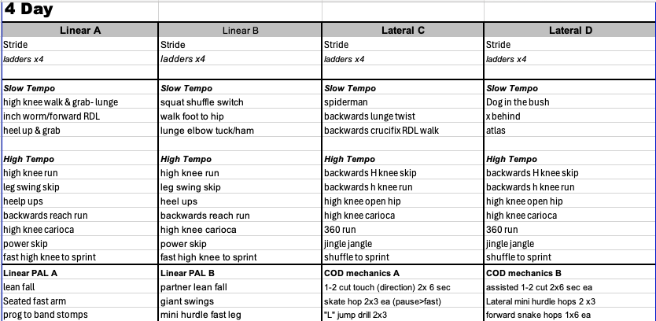
4 Day Warm Up

Slide 30
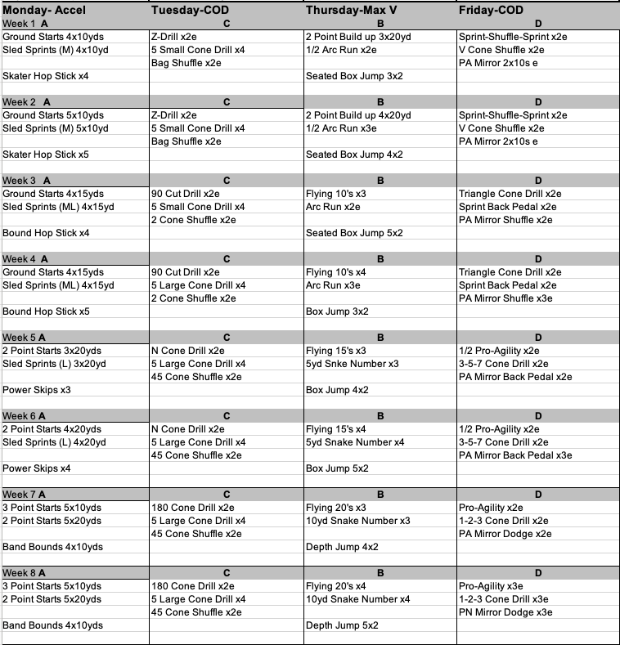
Sample
4 Day Program

Slide 31
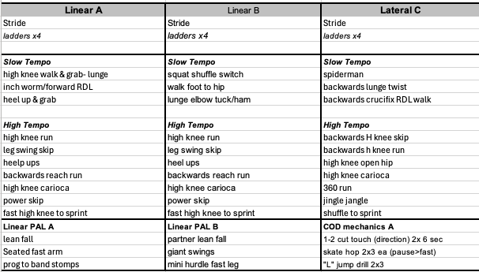
3 Day Warm Up

Slide 32
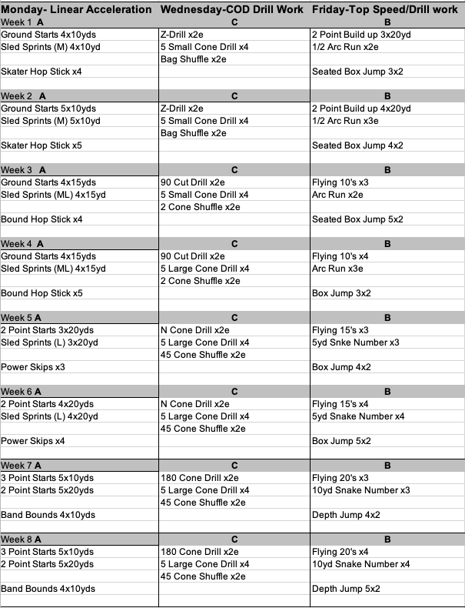
Sample
3 Day Program

Slide 33
Thank you.
Contact bkmitta@huskers.com

