Slide 1
Principles of Training Athletes
Specificity, biomotor abilities, biomechanics, and progressive overload — built on the Husker Power Principles
Principles of Training Athletes
1
Notes:
Title slide.

Slide 2
Why Principles?
Principles are true.
Methods change. Trends change. Principles don't — they hold regardless of sport, equipment, or era.
Principles of Training Athletes
2
Notes:
Set up the whole deck: everything that follows is a principle, not a trend.

Slide 3
The Husker Power Principles
All ten, at a glance
1
Multi-Joint Movements
6
Seasonal Application
2
Ground-Based Activities
7
Split Program
3
Three-Dimensional Activities
8
Heavy-Light System
4
Explosive Training
9
Interval Training
5
Progressive Overload
10
Correct Energy System
Principles of Training Athletes
3
Notes:
All ten Husker Power Principles listed together before the deep dives on Specificity and Progressive Overload.

Slide 4
Principles
Four pillars of the program
1
Periodization
Structuring training over time to peak performance when it matters most.
2
Specificity
Training must match the specific demands of the sport.
3
Progressive Overload
Systematically increasing demands so adaptation keeps happening.
4
Progression
The program evolves as the athlete does — simple before complex.
Principles of Training Athletes
4
Notes:
Roadmap slide: the four principles the rest of the deck is organized around.

Slide 5
PRINCIPLE
Periodization
Principles of Training Athletes
5

Slide 6
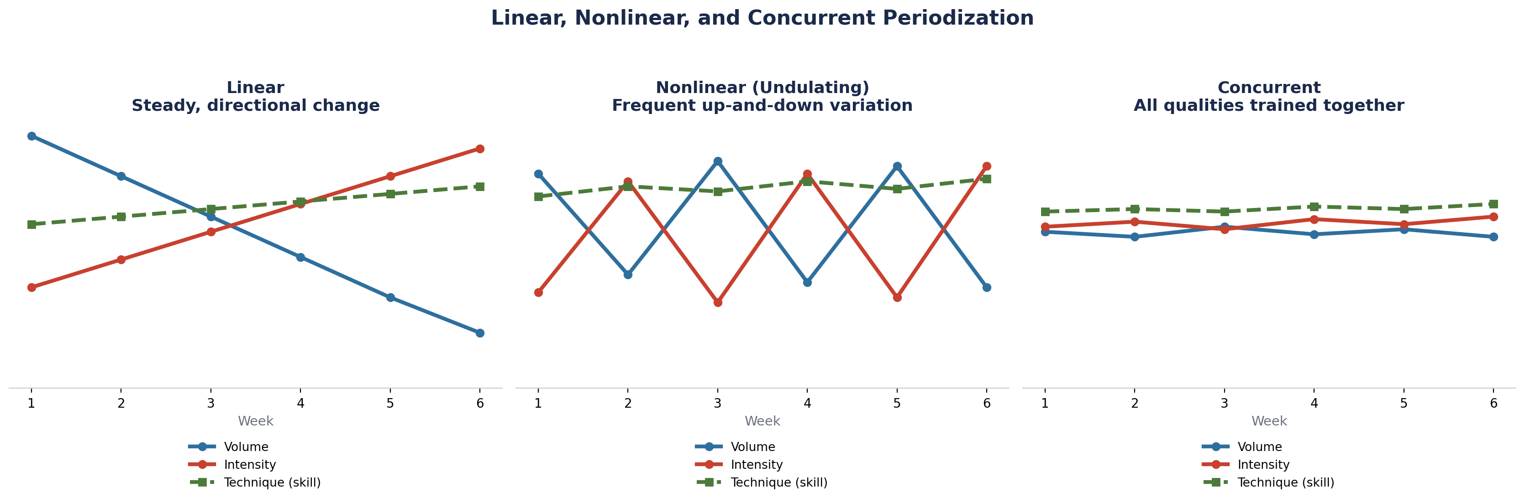
Linear, Nonlinear, and Concurrent
Three ways to sequence and organize volume, intensity, and technique
Principles of Training Athletes
6
Notes:
Linear periodization moves volume and intensity in one direction across the block. Nonlinear (undulating) periodization varies them frequently, week to week or day to day. Concurrent periodization trains volume, intensity, and technique together at moderate levels throughout. Technique work stays consistently high across all three models.

Slide 7
Peaking
Training over time to maximize performance at key times of the year.
Principles of Training Athletes
7
Notes:
Peaking is the payoff of periodization: everything upstream exists to put an athlete at their best when it counts most.

Slide 8
Managing Fatigue
What peaking plans are ultimately protecting
Minimizing Injury Risk
Reduce accumulated fatigue and structural strain before they become injuries.
Minimizing Burnout
Prevent the psychological and physiological staleness of chronic overreach.
Principles of Training Athletes
8
Notes:
Managing fatigue is the constraint that peaking and periodization are built around — it's not optional.

Slide 9
PRINCIPLE
Specificity
Principles of Training Athletes
9

Slide 10
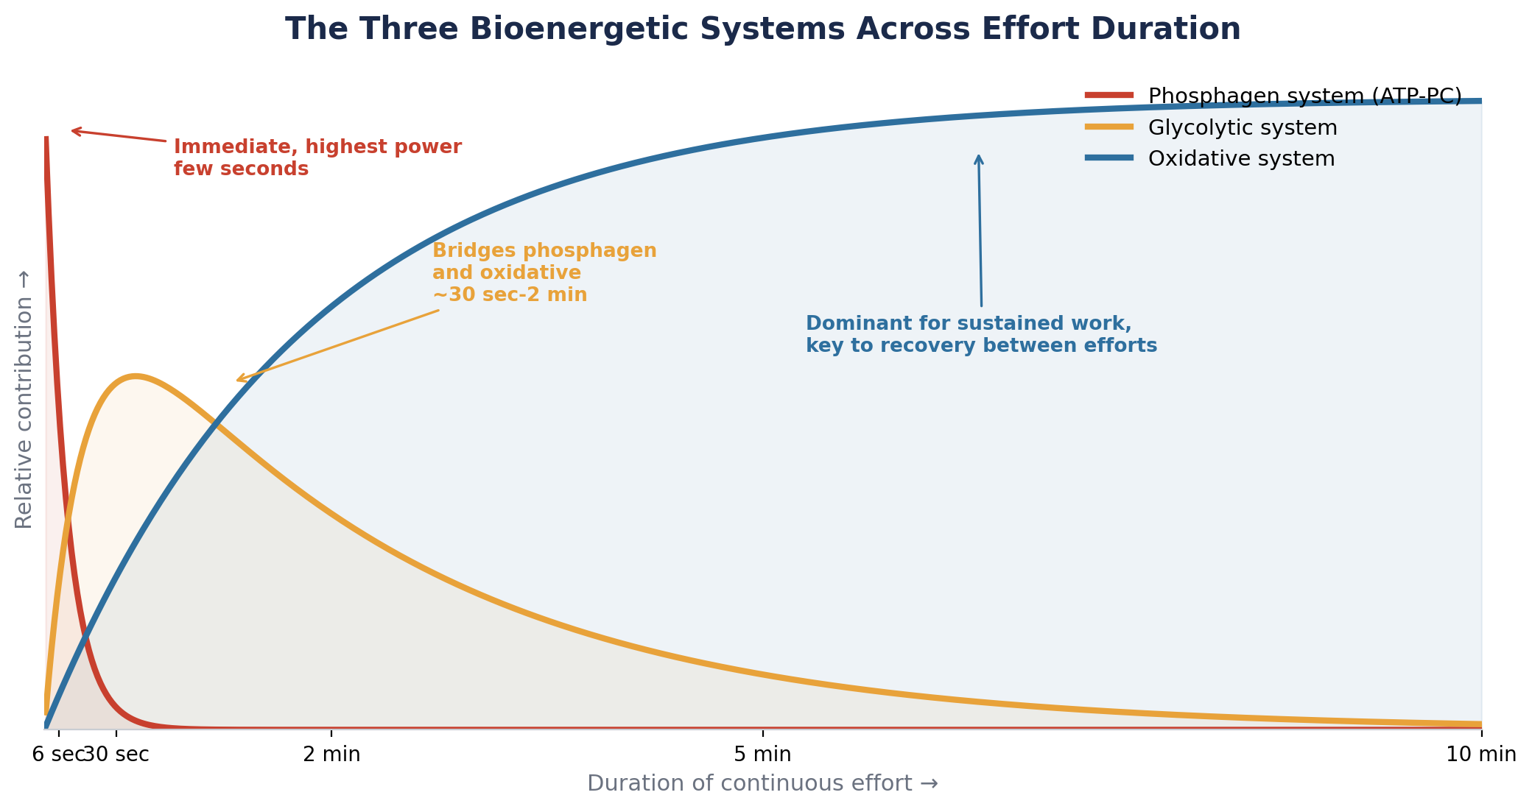
Bioenergetic System
The three energy systems specificity has to account for
Phosphagen System
Most team-sport actions call on this for power over capacity — immediate, highest output, first few seconds.
Glycolytic System
Limited compared to the phosphagen and oxidative systems — use it strategically, not as a default.
Oxidative System
Develops the capacity of all three systems and enhances recovery between efforts.
Principles of Training Athletes
10
Notes:
Specificity starts with knowing which energy system the sport actually demands, and when.

Slide 11
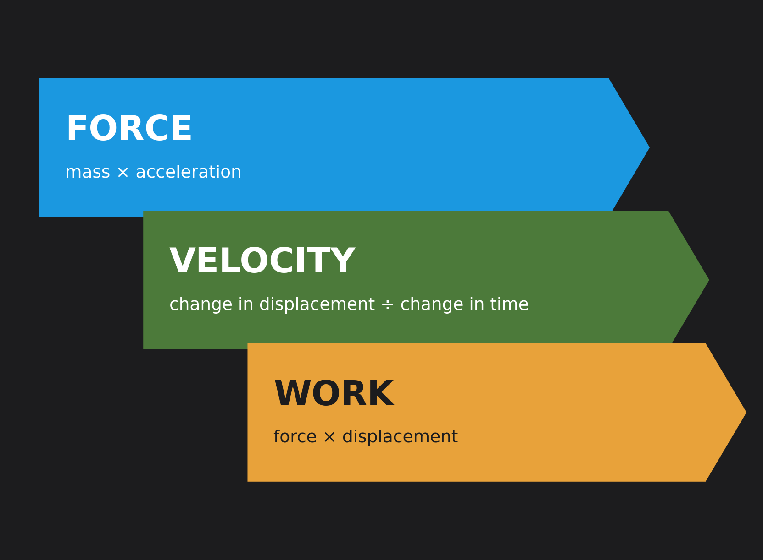
Biomotor Abilities
The three qualities every program is ultimately training
Force
The ability to move an external mass, regardless of time.
Velocity
Improve the rate of force development.
Work
Work capacity — the total work an athlete can perform and sustain.
Principles of Training Athletes
11
Notes:
Force, velocity, and work — the three biomotor abilities, with the formula that defines each.

Slide 12
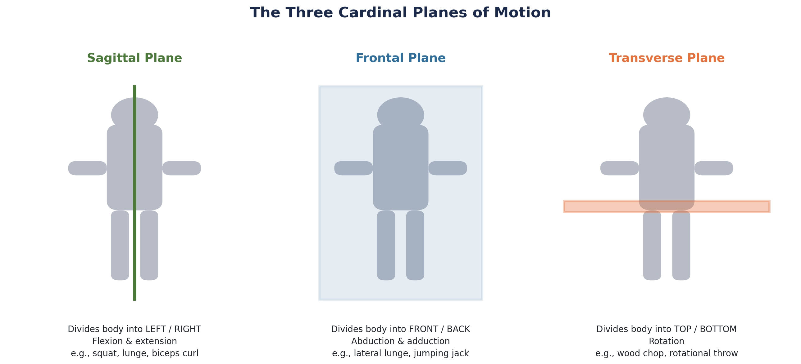
Biomechanics
The cardinal planes every movement pattern lives in
Cardinal Planes: Sagittal • Frontal • Transverse
Principles of Training Athletes
12
Notes:
Every exercise selection decision should be traceable back to one (or more) of these three planes.

Slide 13
Cardinal Movements
The movement patterns that cover the full range of biomechanics
Squat
Horizontal & Vertical Upper-Body Push
Lunge
Horizontal & Vertical Upper-Body Pull
Hinge
Carry
Knee-Dominant / Posterior Chain
Rotation
Principles of Training Athletes
13
Notes:
Eight movement patterns, drawn directly from the three cardinal planes on the previous slide.

Slide 14
PRINCIPLE
Progressive Overload
Principles of Training Athletes
14

Slide 15
Types of Progressive Overload
Three levers, not one
Intensity
Volume
Density
Increase external load.
Increase time under tension, reps, and sets.
Compress time, or expand volume, within the same session.
Principles of Training Athletes
15
Notes:
Coaches default to intensity alone — volume and density are just as valid, and often safer, levers.

Slide 16
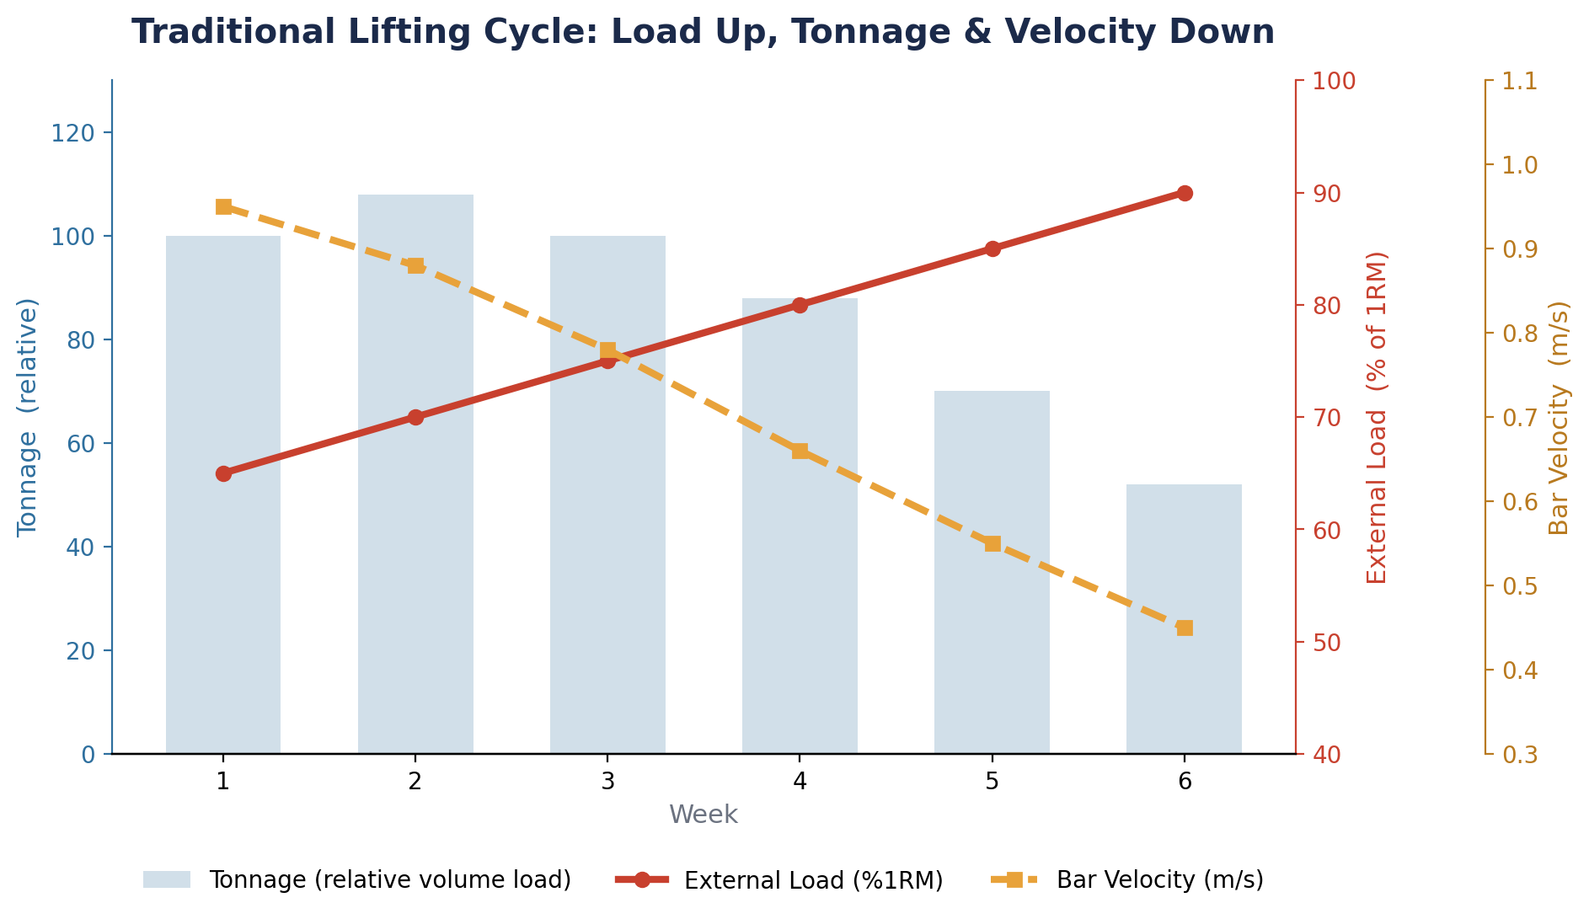
Intensity
The first lever of progressive overload
External Load
The percentage of 1RM, or absolute weight, being lifted.
Tonnage Increase
Total volume load (sets × reps × weight) rises across the block.
Velocity
Bar speed slows as external load climbs toward peak.
Principles of Training Athletes
16
Notes:
A traditional lifting cycle: as external load climbs, tonnage and bar velocity both come down.

Slide 17
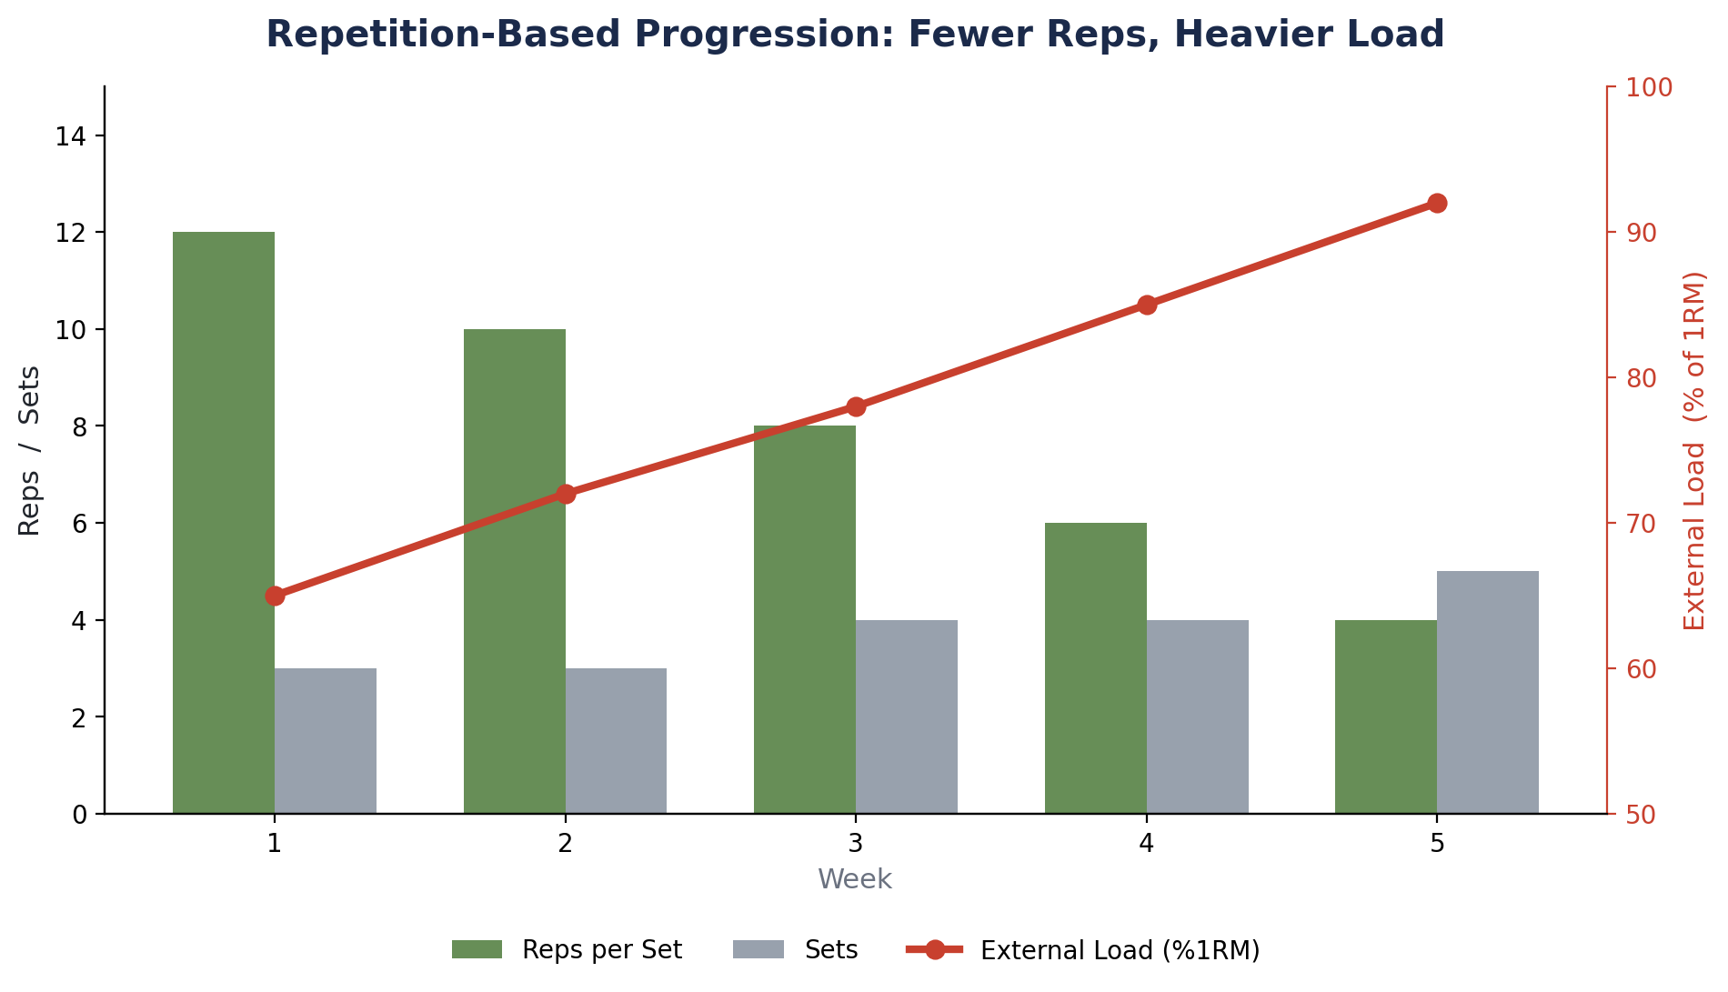
Volume
The second lever of progressive overload
Reps
Repetitions performed per set.
Time Under Tension
Total time the muscle spends under load.
Sets
Number of sets performed per exercise.
Principles of Training Athletes
17
Notes:
A rep-based progression: reps come down while load and sets climb across the block.

Slide 18
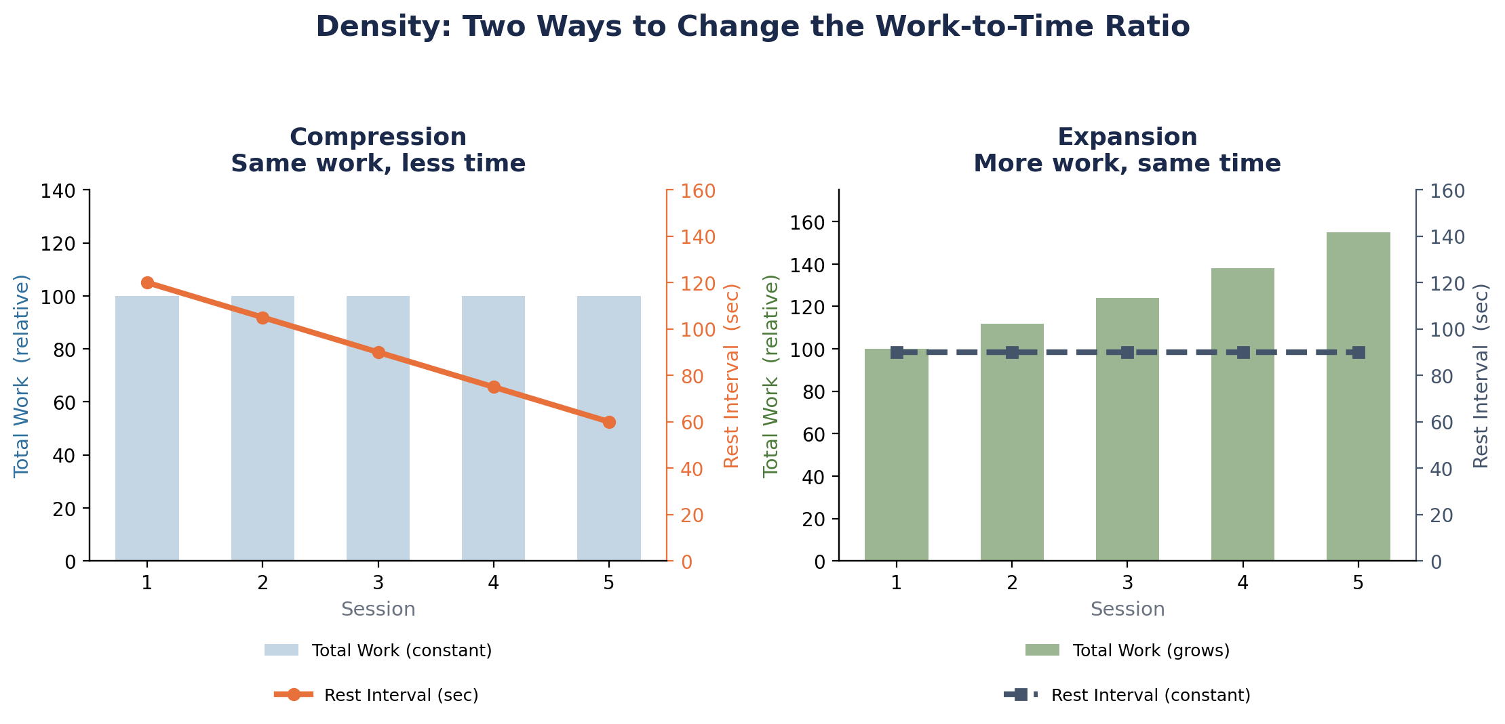
Density
The third lever of progressive overload
Compression • Expansion
Principles of Training Athletes
18
Notes:
Compression: same work in less time (rest shrinks). Expansion: more work in the same time (volume grows).

Slide 19
PRINCIPLE
Progression
Principles of Training Athletes
19

Slide 20
Training Needs to Evolve for New Demands
Programming has to keep pace as demands on the athlete change
Start Simply
It lets you troubleshoot problems before things get complex.
Principles of Training Athletes
20
Notes:
Progression means the program evolves as the athlete does — start simple so problems surface while they're still easy to fix.

Slide 21
Assessing Where to Start
Matching training emphasis to the athlete in front of you
Low Sport Skill
Emphasize more specific work.
Low Physical Development
Emphasize more general work.
Low in Both
Progress the athlete from general work toward specific work.
Principles of Training Athletes
21
Notes:
Where an athlete starts on the general-to-specific continuum depends on which is actually lacking: sport skill, physical development, or both.

Slide 22
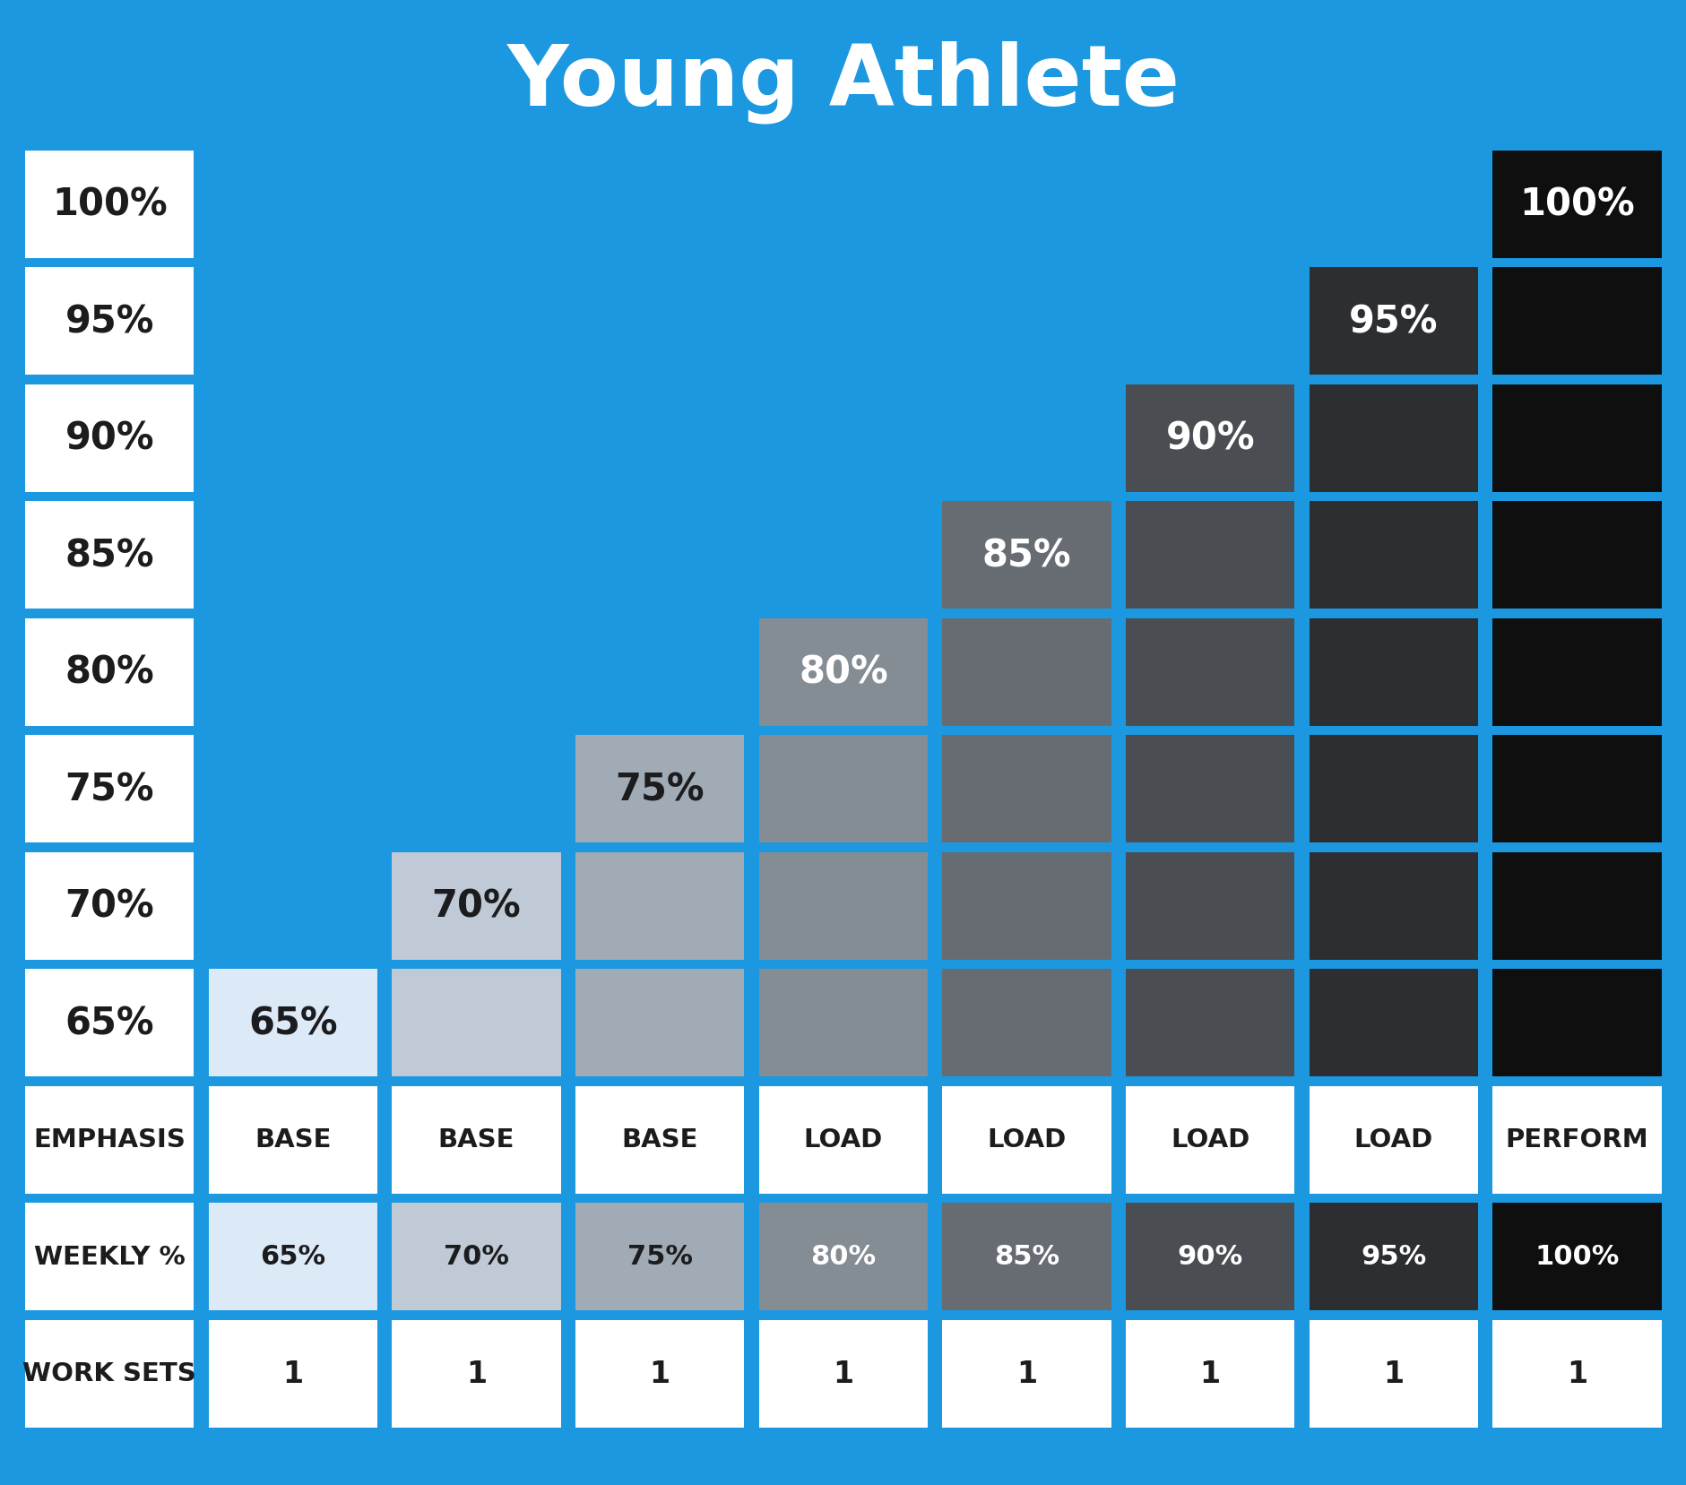
Young Athletes
Develop fast.
Progress slow.
Principles of Training Athletes
22
Notes:
Young athletes adapt quickly session to session, but the overall program should still advance conservatively — steady linear progression, one work set throughout.

Slide 23
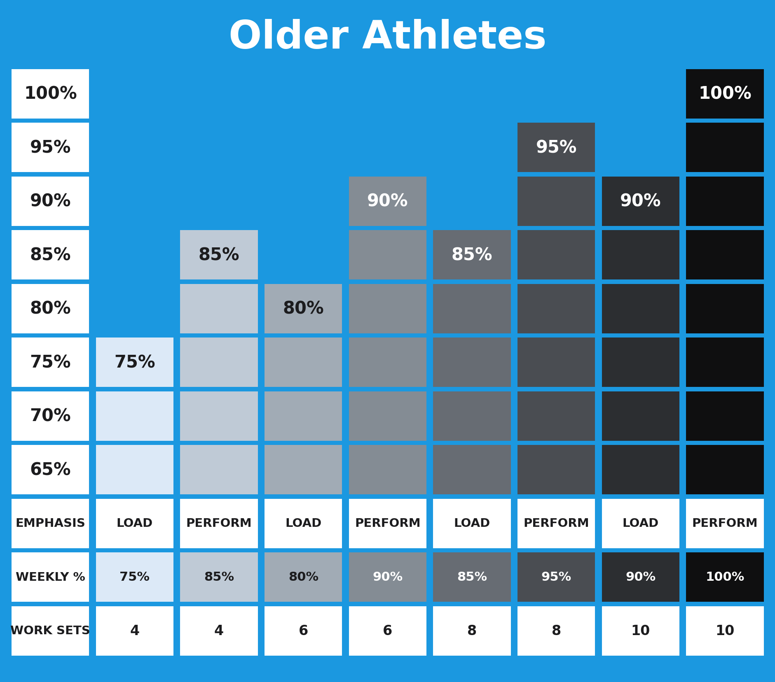
Older Athletes
Develop slow.
Progress fast.
Principles of Training Athletes
23
Notes:
Older, more trained athletes adapt more slowly session to session, but the overall program can be advanced more aggressively — undulating load/perform waves with rising work sets.

Slide 24
Principles
Four pillars of the program
1
Periodization
Structuring training over time to peak performance when it matters most.
2
Specificity
Training must match the specific demands of the sport.
3
Progressive Overload
Systematically increasing demands so adaptation keeps happening.
4
Progression
The program evolves as the athlete does — simple before complex.
Principles of Training Athletes
24
Notes:
Roadmap slide: the four principles the rest of the deck is organized around.

Slide 25
PRINCIPLE
Principles of Speed Development
Principles of Training Athletes
25

Slide 26
DEFINE
What is Speed?
Principles of Training Athletes
26

Slide 27
Linear Speed
Definition
The skills and abilities needed to achieve high movement velocities — usually quantified by time or yards per second.
40 yd
8.7 yd
=
4.6 s
s
Principles of Training Athletes
27
Notes:
Linear speed is the foundation everything else in this section builds from.

Slide 28
Sprinting
Acceleration Training
0–30 yards.
Max Velocity
Beyond 30 yards.
Principles of Training Athletes
28
Notes:
Sprinting splits into two distinct phases, each trained differently.

Slide 29
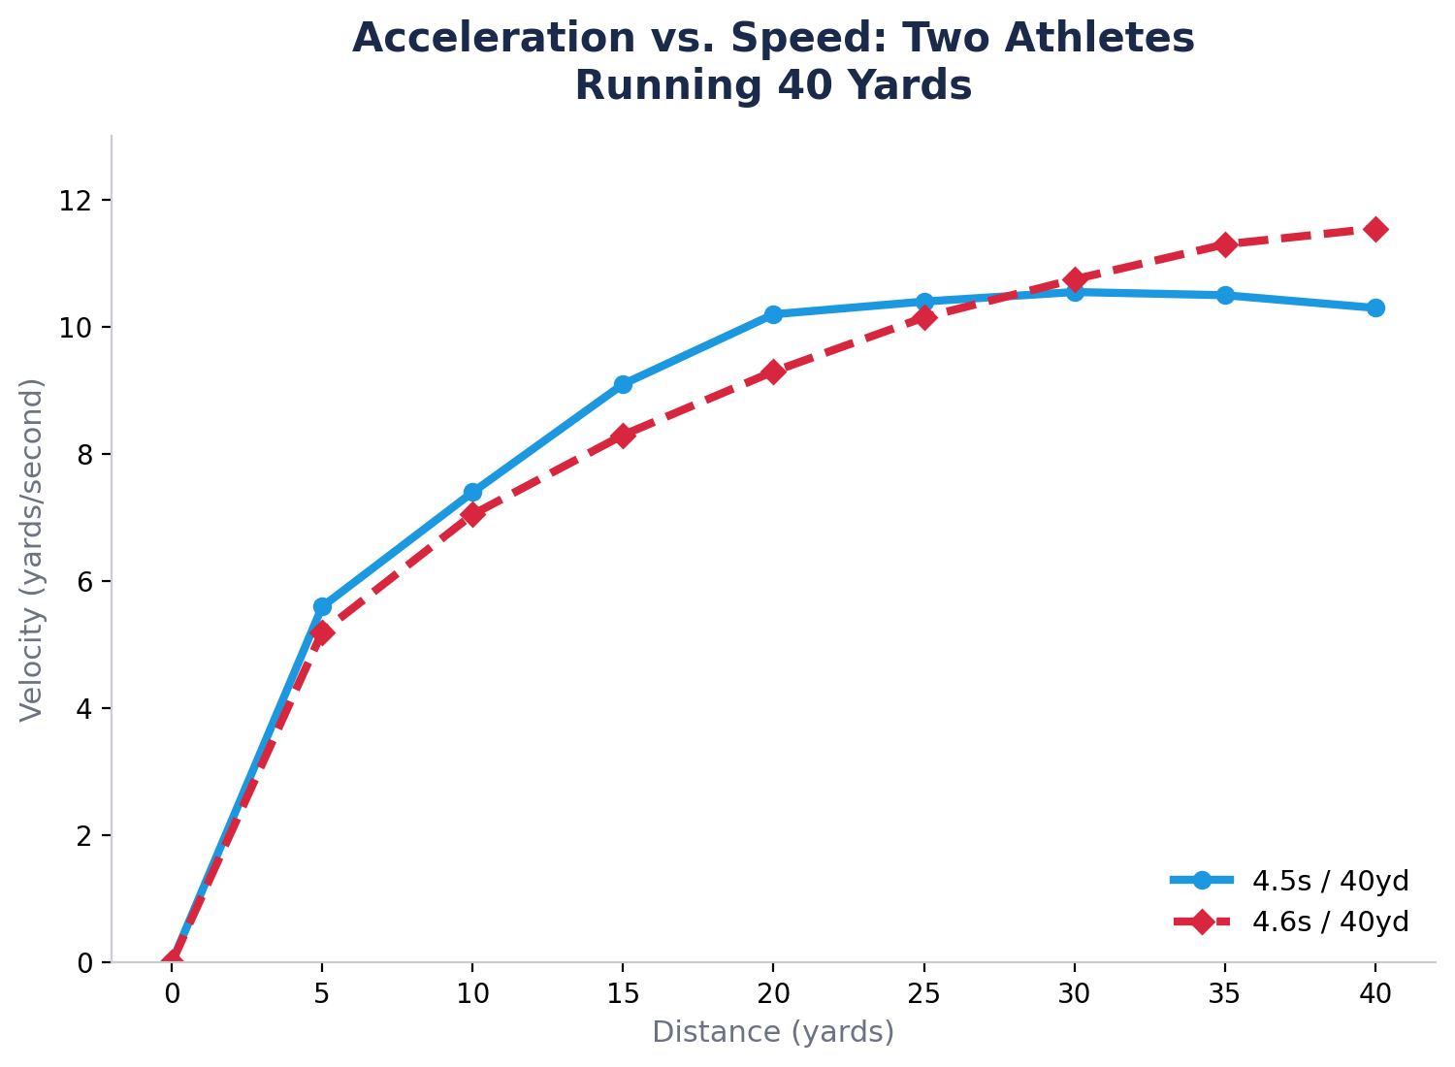
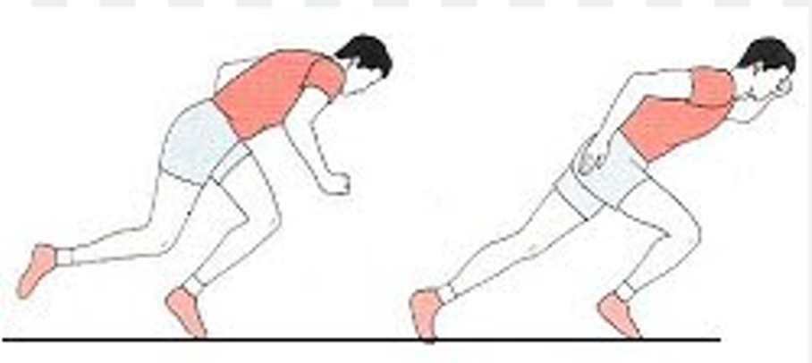
Acceleration
The first phase of a sprint
Principles of Training Athletes
29
Notes:
Acceleration versus speed in two athletes over 40 yards.

Slide 30
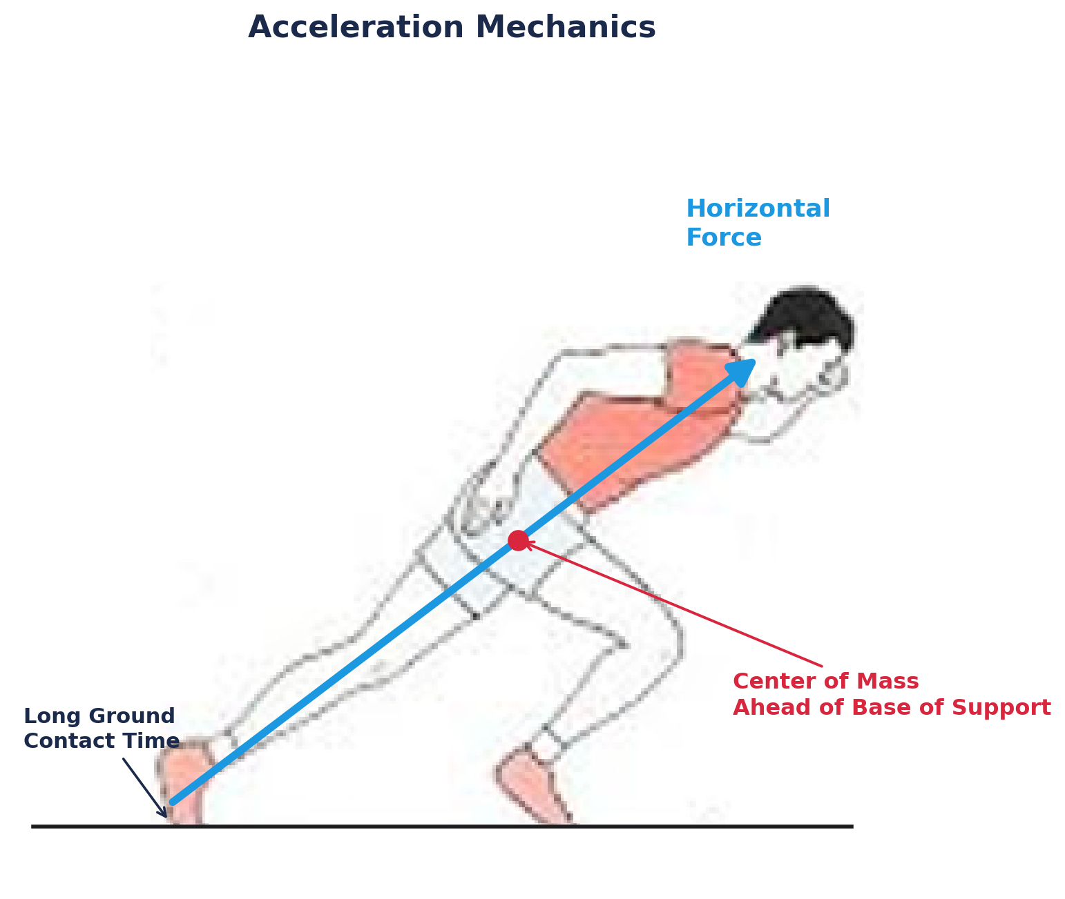
Acceleration Mechanics
Horizontal Force
Center of Mass in Front of Base of Support
Long Ground Contact Times
Large Joint Angles
Low Flight Times
Short Stride Length
Low Stride Frequency
Principles of Training Athletes
30
Notes:
Acceleration mechanics: a forward lean that puts the center of mass ahead of the base of support.

Slide 31
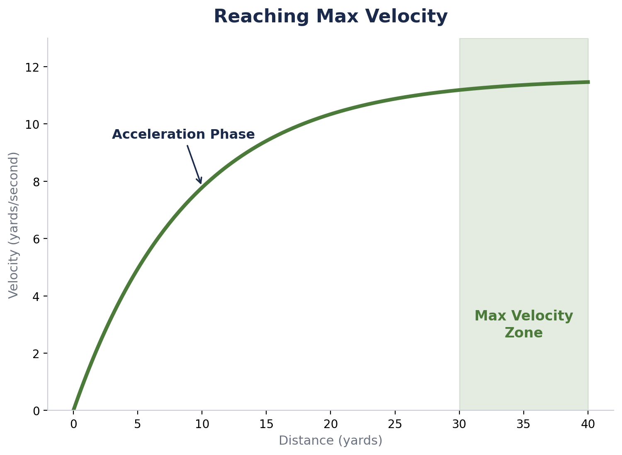
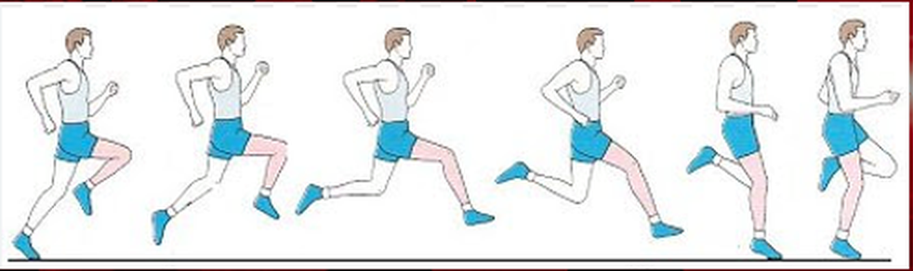
Max Velocity
The second phase of a sprint
Principles of Training Athletes
31
Notes:
Max velocity is reached once acceleration mechanics give way to an upright sprint posture.

Slide 32
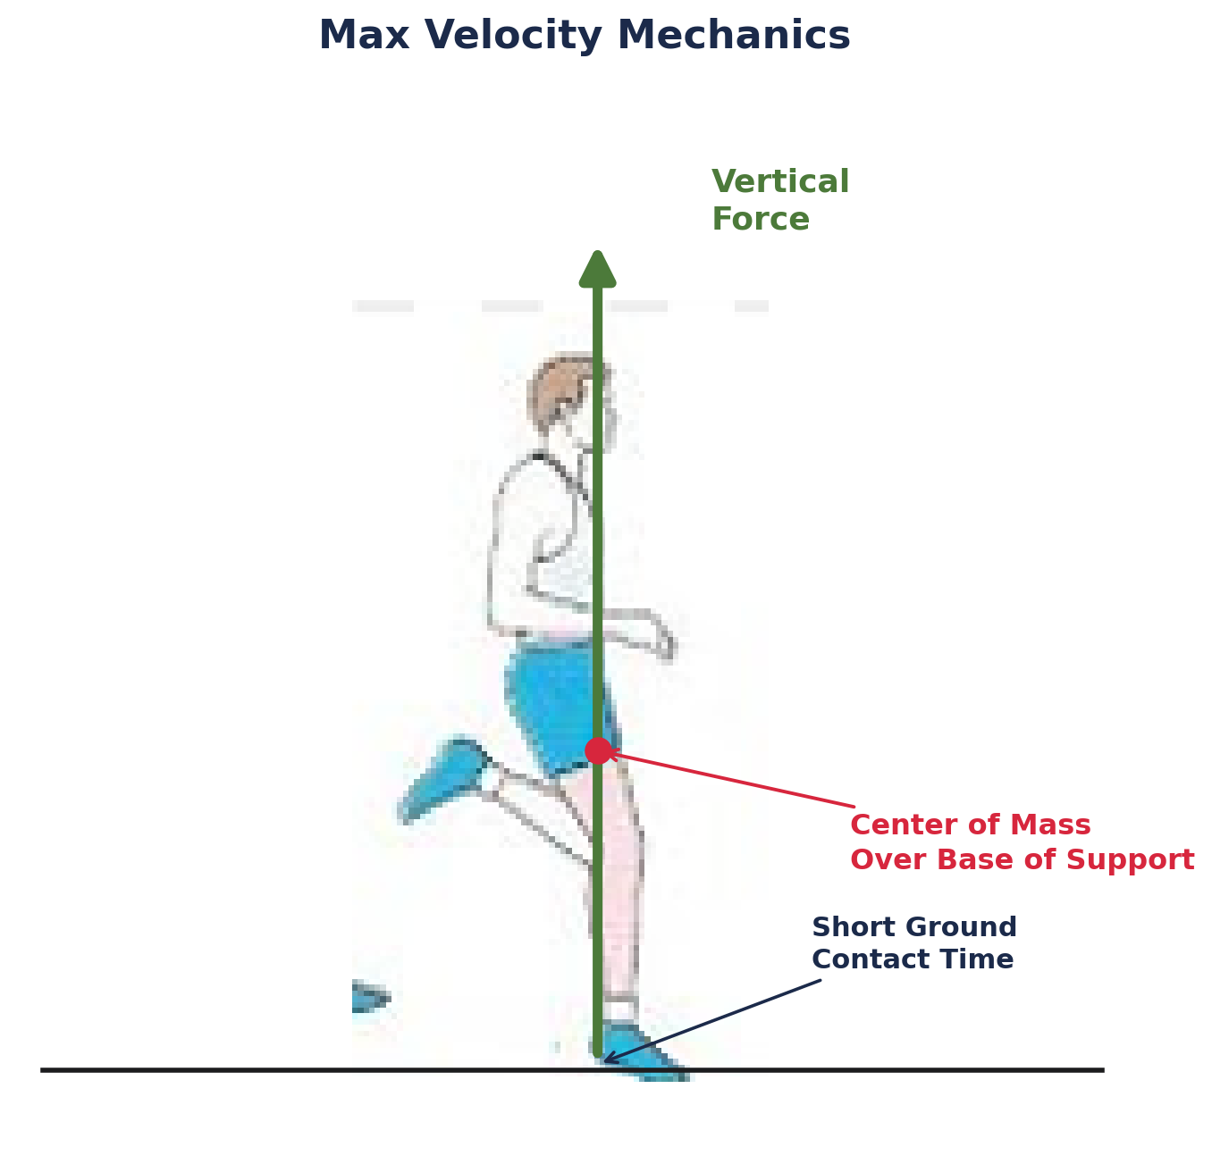
Max Velocity Mechanics
Vertical Force
Center of Mass Over Base of Support
Short Ground Contact Time
Small Joint Angles
High Flight Times
Long Stride Length
High Stride Frequency
Principles of Training Athletes
32
Notes:
Max velocity mechanics are the mirror image of acceleration: vertical force instead of horizontal.

Slide 33
OVERVIEW
Principles of Speed Development
Principles of Training Athletes
33

Slide 34
Build Maximum Force
Horizontal Force in the First Steps
Athletes who produce greater horizontal force during the first few steps generally accelerate better.
Principles of Training Athletes
34
Notes:
Maximum force production early in the sprint is the single biggest driver of acceleration quality.

Slide 35
Sprint at Maximum Speed
To Become Fast, You Need to Sprint Fast
95–100% Effort
Full Recovery
Low Fatigue
Principles of Training Athletes
35
Notes:
Top-end speed only improves when the sprint itself is truly maximal — near-full effort, fully recovered, low fatigue.

Slide 36
Develop Elastic Qualities
Stiffness and Reactive Strength
Max velocity requires stiffness and reactive strength.
Principles of Training Athletes
36
Notes:
Elastic qualities — stiffness and reactive strength — are what let an athlete convert ground contact into speed at max velocity.

Slide 37
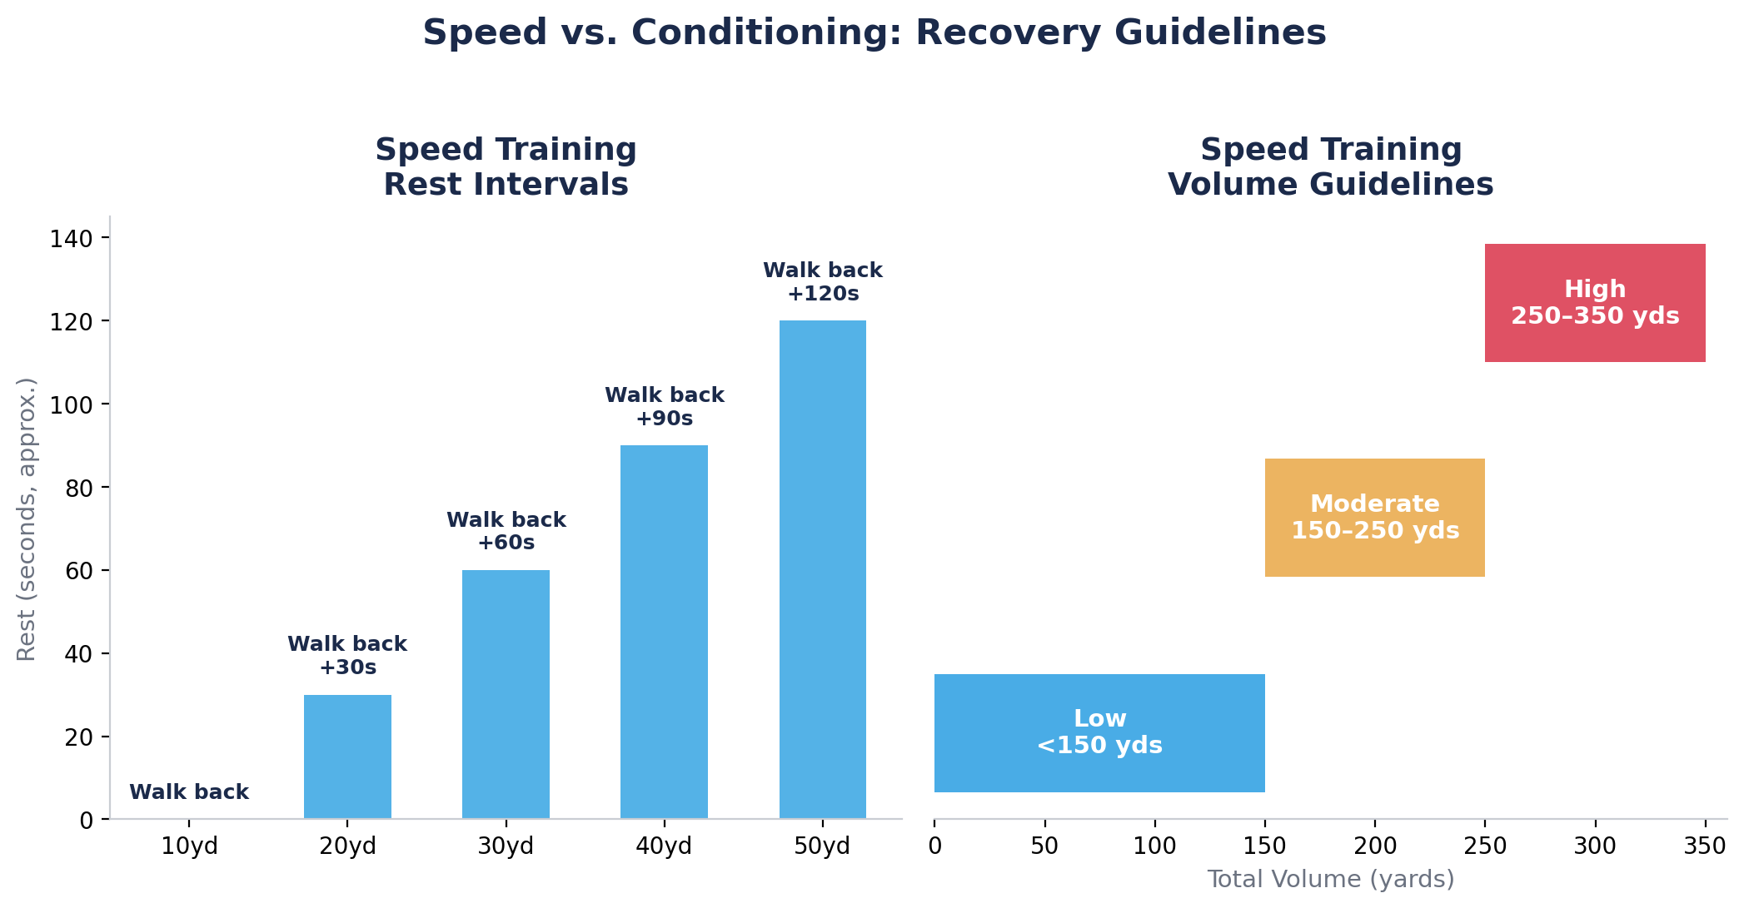
Recover Completely
High-Quality Recovery
High-quality sprint work requires high-quality recovery.
Principles of Training Athletes
37
Notes:
Recovery guidelines scale with sprint distance — rest intervals and total volume both matter.

Slide 38
DEFINE
What is Change of Direction?
Principles of Training Athletes
38

Slide 39
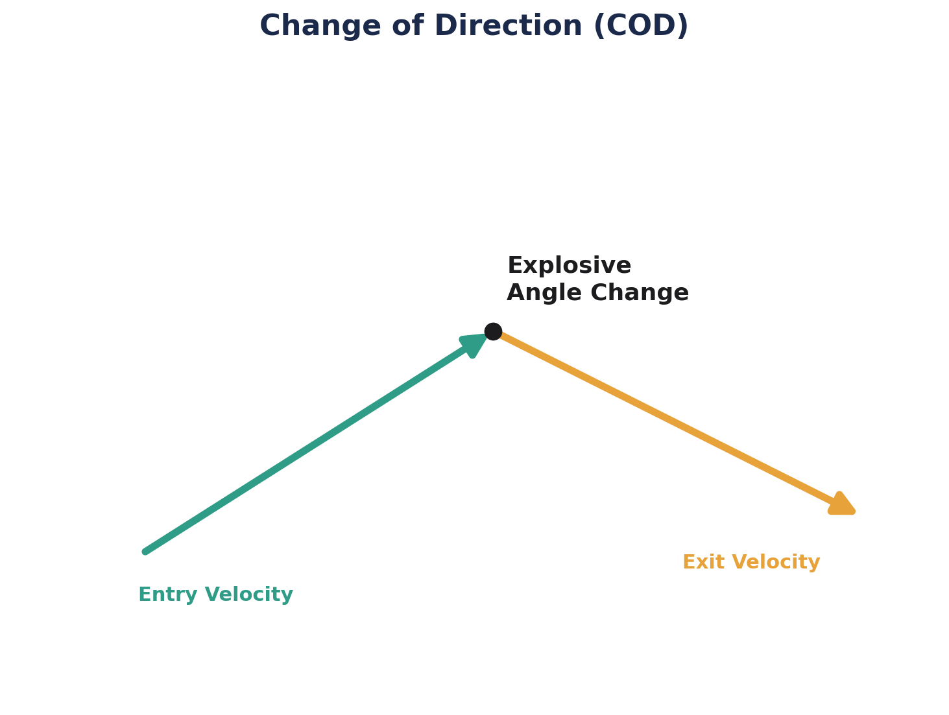
Change of Direction (COD)
Definition
The skills and abilities needed to explosively change movement direction, velocities, or modes.
Principles of Training Athletes
39
Notes:
COD is explosive and pre-planned — distinct from the reactive nature of agility.

Slide 40
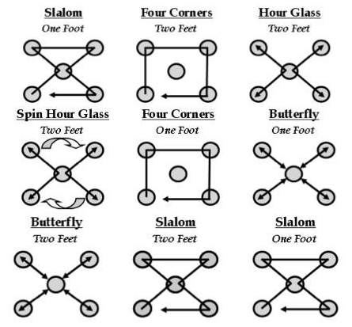
Change of Direction (COD)
Three training categories
Pre-Planned
Focus Mechanics
Cone-Based Drill
Principles of Training Athletes
40
Notes:
COD training starts pre-planned and mechanics-focused, using cone-based drills.

Slide 41
COD Training Progression
Simple to Complex
Lower-Intensity Drills to Higher-Intensity Drills
Closed Drills to Open Drills
Principles of Training Athletes
41
Notes:
COD progresses along three continuums at once: complexity, intensity, and openness.

Slide 42
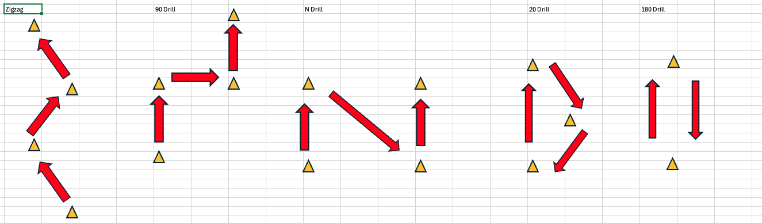
Angle-Velocity and Progressive Overload
Principles of Training Athletes
42
Notes:
COD drills progress from tighter, sharper angle changes toward broader, faster ones as athletes advance.

Slide 43
DEFINE
What is Agility?
Principles of Training Athletes
43

Slide 44
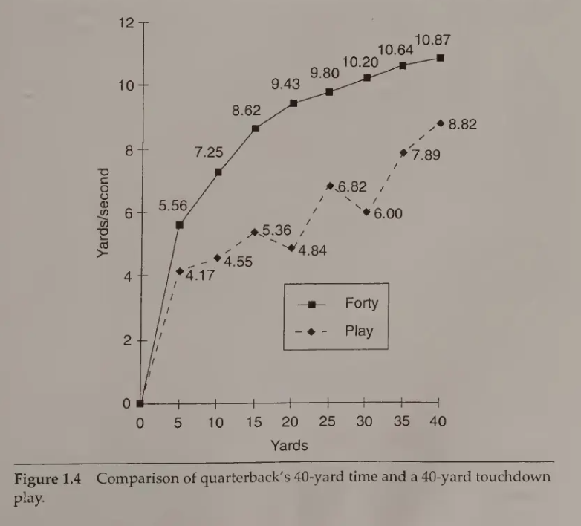
Agility
Definition
The skills and abilities needed to change direction, velocity, or mode in response to a stimulus.
Principles of Training Athletes
44
Notes:
The defining difference from COD: agility is reactive, driven by an external stimulus.

Slide 45
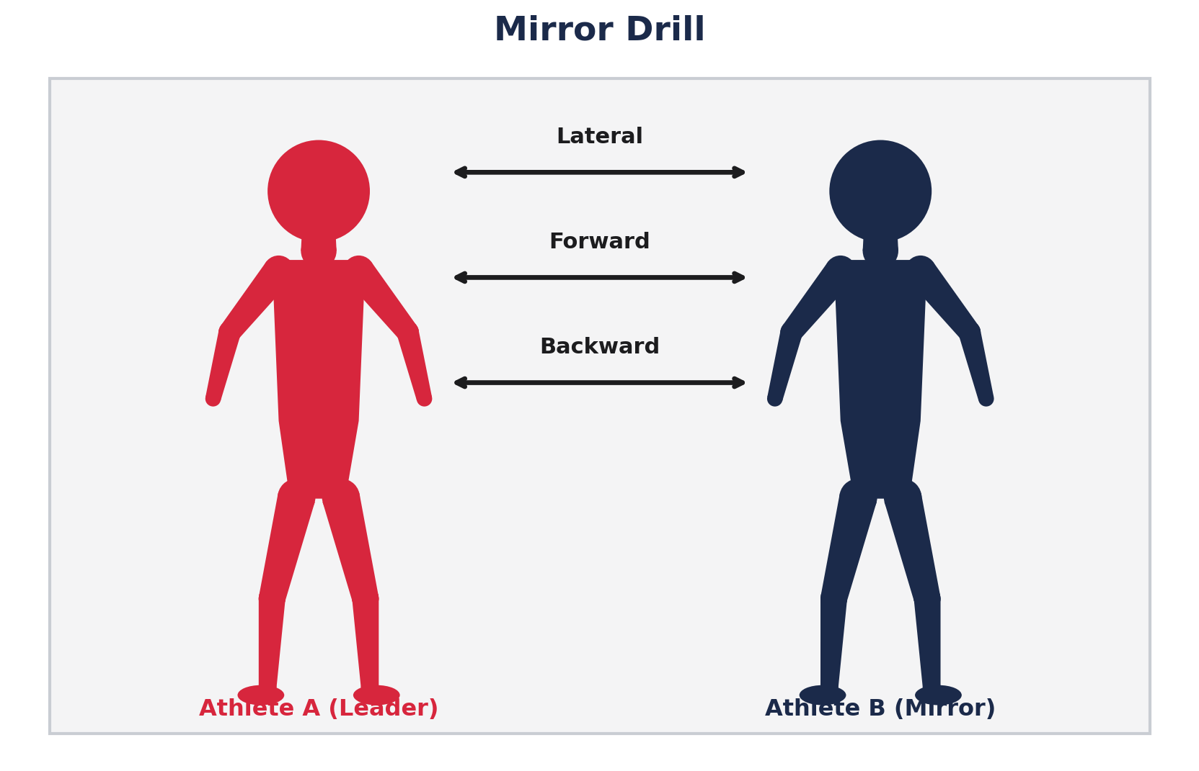
Agility
Three defining qualities
Reactive
Focus on Perception / Action
Open Drills to Game-Like
Principles of Training Athletes
45
Notes:
Agility training builds toward game-like, open decision-making — the mirror drill is a classic bridge.

Slide 46
Principles of Change of Direction and Agility
Shared progressions across COD and agility training
1
Simple to Complex
Master basic movement patterns before layering in complexity.
2
Low to High Intensity
Build control at lower speeds and loads before pushing toward game speed.
3
Closed to Open
Progress from predictable, closed drills to open, reactive ones that mirror competition.
Principles of Training Athletes
46
Notes:
COD and agility training both progress along the same three continuums: complexity, intensity, and predictability/openness.

Slide 47
Simple to Complex
Build Braking Ability First
Master Deceleration
Teach Efficient COD Technique
Principles of Training Athletes
47
Notes:
Simple to complex: braking ability first, then deceleration mechanics, then full COD technique.

Slide 48
Low to High Intensity
Develop Reactive Strength
Integrate with Speed Training
Principles of Training Athletes
48
Notes:
Low to high intensity: build reactive strength first, then integrate COD work with speed training.

Slide 49
Closed to Open
Planned to Reactive
Train Multiple Movement Patterns
Principles of Training Athletes
49
Notes:
Closed to open: move from planned, predictable drills to reactive ones across multiple movement patterns.

Slide 50
Why You Should Train Speed
Speed Development
Strength Development
Reduce Risk of Soft-Tissue Injury
Motor Learning
Principles of Training Athletes
50
Notes:
Speed training pays dividends well beyond speed itself.

Slide 51
METHODS
Types of Speed Training
Principles of Training Athletes
51

Slide 52
Sport-Specific Movement Types
Evasion, subtle change of direction, and velocity maintenance
Evasion
Rapid, large-angle directional change to avoid an opponent or create separation.
Subtle Change of Direction
Small to moderate direction shifts made while maintaining movement rhythm and positioning.
Velocity Maintenance
Continuation of sprinting while navigating small directional adjustments without reducing speed.
Principles of Training Athletes
52
Notes:
Three sport-specific movement types: evasion (most explosive), subtle COD (keeps rhythm/positioning), and velocity maintenance (no speed penalty for small course corrections).

Slide 53
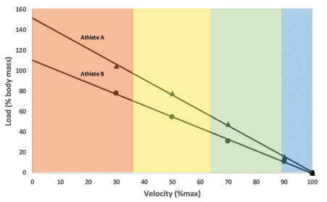
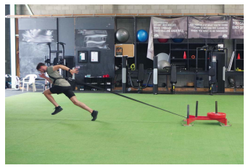
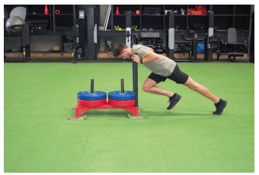
Resisted Sprint Training
Sled push, band/sled towing, weight vest, hill/stadium, and running into the wind
Principles of Training Athletes
53
Notes:
Resisted sprinting shifts the load-velocity profile — heavier loads bias force, lighter loads preserve velocity.

Slide 54
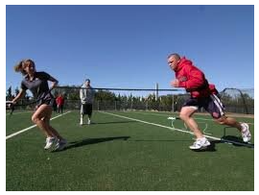
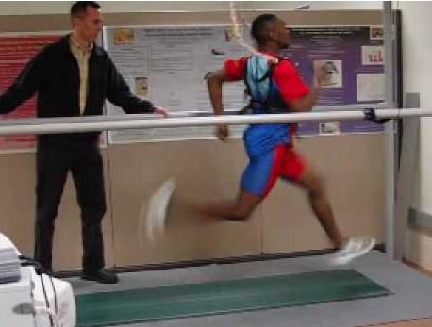
Assisted Sprint Training
Band/cord, towing systems, high-speed treadmills, downhill, and running with the wind
Principles of Training Athletes
54
Notes:
Assisted sprinting exposes athletes to velocities above what they can produce on their own.

Slide 55
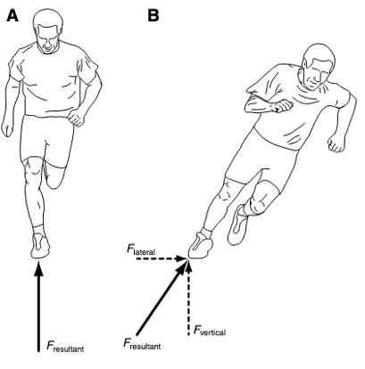
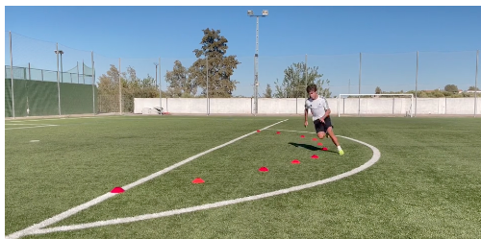
Curvilinear Sprinting
Sprinting along a curved or arcing path
Principles of Training Athletes
55
Notes:
Curved sprinting adds a lateral force component that straight-line sprinting never trains.

Slide 56
APPLICATION
Program Design
Principles of Training Athletes
56

Slide 57

STRENGTH & CONDITIONING COACHES CLINIC
BUILDING CHAMPIONSHIP
TEAMS
Concepts, methods, and programming — a practical framework for developing high school athletes.
NEBRASKA STRENGTH & CONDITIONING / NSAA OFFICIAL PARTNER
57

Slide 58



WHY THIS MATTERS
01
MOST PROGRAMS FAIL ON PROCESS, NOT EFFORT
RANDOM WORKOUTS
NO CLEAR TARGET
SAME THING YEAR-ROUND
Exercises chosen by feel or tradition, with no thread connecting day to day.
Training isn't aimed at anything measurable, so progress can't be seen.
No planned variation means stagnation, staleness, and avoidable injury.
THE FIX: a process you run every time — the same questions, asked in the same order.
NEBRASKA STRENGTH & CONDITIONING / NSAA OFFICIAL PARTNER / NEBRASKASC.COM
58

Slide 59







THE ROADMAP
SEVEN STEPS, ONE REPEATABLE LOOP
1
2
3
4
5
6
7
NEEDS ANALYSIS
LTAD LENS
DEFINE KPIS
TEST & BENCHMARK
SET GOALS
PERIODIZE
REASSESS
Steps 1–6 build the plan. Step 7 feeds back to Step 1 — programming is a loop, not a line.
59

Slide 60




STEP 0 · WHERE TO BEGIN
01
START WITH THE ATHLETE IN FRONT OF YOU
Before you write a single set, answer three grounding questions. Your whole program is the answer to these.
WHO AM I COACHING?
Age, training age, maturity, sport, group size, time of year.
COACH'S REALITY CHECK
WHAT DO I ACTUALLY HAVE?
The best program on paper is worthless if it doesn't fit your gym, your schedule, and your kids. Constraints aren't obstacles — they're your starting data.
Equipment, facility, contact time per week, staff-to-athlete ratio.
WHERE ARE WE GOING?
The outcome that defines success for this group, this season.
NEBRASKA STRENGTH & CONDITIONING / NSAA OFFICIAL PARTNER / NEBRASKASC.COM
60

Slide 61
CONCEPTS · HUSKER POWER — BRIAN KMITTA II, NEBRASKA VOLLEYBALL
TEN HUSKER POWER PRINCIPLES
PRINCIPLES 1–5
PRINCIPLES 6–10
Multi-joint movements
Ground-based activities
Three-dimensional activities
Explosive training
Progressive overload
Seasonal application
Split program
Heavy-light system
Interval training
Correct energy system
NEBRASKA STRENGTH & CONDITIONING / NSAA OFFICIAL PARTNER / NEBRASKASC.COM
61

Slide 62




CONCEPTS · PRINCIPLES OF TRAINING
FOUR PRINCIPLES BEHIND EVERY PROGRAM
The concepts underneath everything that follows — each one gets its own methods on the next slides.
SPECIFICITY
PERIODIZATION
OVERLOAD
PROGRESSION
Train what you want to improve — adaptations match the stimulus you apply.
Plan training over time so athletes peak when it matters most.
Progressively raise intensity, volume, or complexity to force new adaptation.
The program evolves as the athlete does — simple before complex.
ONE THREAD. Every method and program later in this deck traces back to these four principles.
NEBRASKA STRENGTH & CONDITIONING / NSAA OFFICIAL PARTNER / NEBRASKASC.COM
62

Slide 63
CONCEPTS · SPECIFICITY
SPECIFICITY: TRAIN WHAT YOU WANT TO IMPROVE
THE CONCEPT
THE METHODS
Adaptations are specific to the stimulus applied
For team sports, training must mimic the demands of the sport
Every method starts with the question: what does the sport ask for?
Strength — muscle actions, ground-based, multi-joint
Speed — maximal intensity
Agility / COD — movement patterns of the sport
Jumps / plyo — force vectors
Conditioning — energy system demands
NEBRASKA STRENGTH & CONDITIONING / NSAA OFFICIAL PARTNER / NEBRASKASC.COM
63

Slide 64
CONCEPTS · PROGRESSIVE OVERLOAD
PROGRESSIVE OVERLOAD: STRESS, ADAPT, REPEAT
THE CONCEPT
THE METHODS
Systematically increase intensity, volume, or complexity
The body adapts to stress — the stimulus must keep rising to drive new adaptation
Progress the dose, not just the effort
Strength — heavy-light system
Speed — short to long
Agility / COD — simple to complex
Jumps / plyo — low-level rhythmic to high power output
Conditioning — low volume to high-output repeat sprints
NEBRASKA STRENGTH & CONDITIONING / NSAA OFFICIAL PARTNER / NEBRASKASC.COM
64

Slide 65
CONCEPTS · PROGRESSION
PROGRESSION: SIMPLE BEFORE COMPLEX
THE CONCEPT
THE METHODS
The program evolves as the athlete does — training keeps pace as demands change
Start simple — it lets you troubleshoot problems before things get complex
Low sport skill — emphasize more specific work
Low physical development — emphasize more general work
Low in both — progress from general work toward specific work
Young athletes — develop fast, progress slow
Older athletes — develop slow, progress fast
NEBRASKA STRENGTH & CONDITIONING / NSAA OFFICIAL PARTNER / NEBRASKASC.COM
65

Slide 66


STEP 1 · NEEDS ANALYSIS
01
NEEDS ANALYSIS: THE DEMANDS VS. THE ATHLETE
Two columns. The gap between them is your program.
DEMANDS OF THE SPORT
PROFILE OF THE ATHLETE
Movement patterns & positions
Energy systems (alactic / lactic / aerobic)
Common injury sites & mechanisms
Competition density & season length
Training history & technical skill
Current strengths & weaknesses
Maturity / growth stage
Injury history & movement quality
NEBRASKA STRENGTH & CONDITIONING / NSAA OFFICIAL PARTNER / NEBRASKASC.COM
66

Slide 67
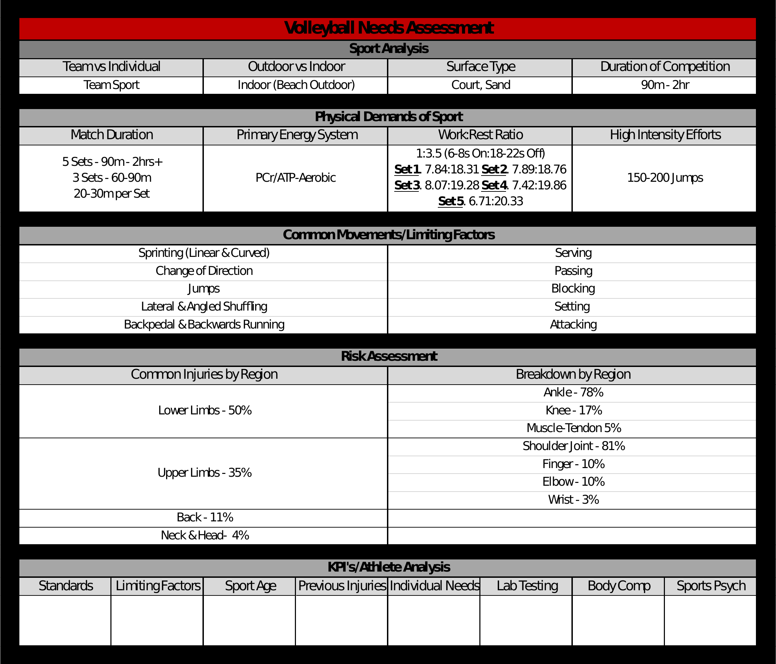
STEP 1 · NEEDS ANALYSIS IN PRACTICE
01
A TEAM NEEDS ASSESSMENT, ON ONE PAGE
NEBRASKA STRENGTH & CONDITIONING / NSAA OFFICIAL PARTNER / NEBRASKASC.COM
67

Slide 68


STEP 2 · LONG-TERM ATHLETIC DEVELOPMENT
COACH THE LONG GAME, NOT JUST THIS SEASON
LTAD is a framework for developing athleticism over years — the right emphasis at the right stage of growth.
NOT MINI-ADULTS
MATURITY > AGE
BUILD, THEN SPECIALIZE
Kids respond to training differently and at different rates — maturity matters more than birthday.
Two 14-year-olds can be years apart developmentally. Program for the body, not the grade.
Broad athletic base first; sport-specific intensity later. It lowers injury risk and raises ceilings.
Source: NSCA Position Statement on Long-Term Athletic Development
68

Slide 69

STEP 2 · LTAD AT NEBRASKA SC
02
THE NSC ATHLETE DEVELOPMENT PATHWAY
One dual-track model for ages 12–18 — the LTAD lens applied to every athlete we coach.
STAGE 01 · LEARN
AGES 12–14 · LEARN TO TRAIN
STAGE 02 · BUILD
AGES 14–16 · TRAIN TO TRAIN
STAGE 03 · COMPETE
AGES 16–18 · TRAIN TO COMPETE
Movement quality & mechanics
Speed & agility development
Strength foundations (neural)
Multi-sport participation
Strength & power development
Sport-specific conditioning
Technical skill refinement
Tactical awareness
Periodized competition prep
Individual performance optimization
Recovery & injury prevention
Mental performance & leadership
“Build the physical foundation for all sport demands”
“Develop the capacity to handle high training loads”
“Peak physically and mentally when it matters most”
PILLAR 1 · PHYSICAL LITERACY — Fundamental movement competency across all sports and environments
PILLAR 2 · TECHNICAL & TACTICAL — Progressive sport-specific skill and game intelligence development
Built on evidence-based Long-Term Athlete Development principles (Balyi, Lloyd & Oliver)
NEBRASKA STRENGTH & CONDITIONING / NSAA OFFICIAL PARTNER / NEBRASKASC.COM
69

Slide 70
STEP 2 · THE PATHWAY IN PRACTICE
02
FROM MODEL TO WEIGHT ROOM, STAGE BY STAGE
Sample exercises and training doses for each stage — adapt them to your facility and your athletes.
LEARN
AGES 12–14
BUILD
AGES 14–16
COMPETE
AGES 16–18
Goblet squat — bodyweight → loaded
Hip hinge / RDL — bodyweight, DB
Lateral ladder & sprint mechanics
Broad jump, med ball slam
Trap bar deadlift, barbell squat, DB RDL
Box jump, hang clean, plyometrics
5-10-5 agility, sprinting, resisted sprints
Circuit complexes — strength / conditioning blend
Barbell squat, power clean, RDL
Hang clean, high level plyometrics, depth jump
Sprinting & sprint loading
Higher intensity loading
Mobility & soft tissue work
2–3 / WK · 30–40 MIN · LOW–MOD
3–4 / WK · 45–60 MIN · MOD–HIGH
4–5 / WK · 60–75 MIN · HIGH, PERIODIZED
TAKE THE ONE-PAGER. This whole pathway — stages, priorities, sample exercises, and training doses — fits on one page. Grab the handout and share it with your staff.
NEBRASKA STRENGTH & CONDITIONING / NSAA OFFICIAL PARTNER / NEBRASKASC.COM
70

Slide 71
STEP 3 · DEVELOPING KPIS
03
KPIS TURN 'GET BETTER' INTO SOMETHING YOU CAN SEE
A Key Performance Indicator is a measurable quality that, if it improves, means your athlete is moving toward the demands of the sport.
RELEVANT
MEASURABLE
REPEATABLE
TRAINABLE
Tied directly to a sport demand from your needs analysis — not a vanity number.
You can put a number on it with the equipment you actually have.
Same test, same setup, every time — so the change is real, not noise.
It responds to your program within a season; otherwise it's just monitoring.
PICK FEW. 3–5 KPIs per group beats 15 you'll never track consistently.
NEBRASKA STRENGTH & CONDITIONING / NSAA OFFICIAL PARTNER / NEBRASKASC.COM
71

Slide 72
STEP 3 · KPI MENU
03
EXAMPLE KPIS BY QUALITY
Quality | Field-friendly test | What it tells you
Lower-body strength | Trap-bar / back squat (rep max or rel. strength) | Force production base for nearly every sport
Power / explosiveness | Vertical jump, broad jump | Rate of force — sprinting, jumping, change of direction
Speed | 10–20 yard sprint (timed) | Acceleration, the most game-relevant speed quality
Change of direction | 5-10-5 pro agility | Deceleration & re-acceleration under control
Conditioning | Yo-Yo / sport-specific repeat efforts | Capacity to repeat high-intensity work
Movement quality | Overhead squat / hop-and-hold screen | Readiness to load & injury-risk flags
NEBRASKA STRENGTH & CONDITIONING / NSAA OFFICIAL PARTNER / NEBRASKASC.COM
72

Slide 73
STEPS 3–4 IN PRACTICE · NEBRASKA VOLLEYBALL
04
KPIS & TESTING INSIDE A CHAMPIONSHIP PROGRAM
EVALUATION TOOLS
WHO FEEDS THE DATA
Force plate jumps
Wellness questionnaires
1080 sprint
Grip testing
Performance testing — 10y dash, pro agility, vertical & approach jump
Sport coaches — sport standards, limiting factors
Athletic medicine — monitoring metrics, previous injuries
NAPL — best practices, consistent data collection
Performance nutrition — body composition, individual needs
NEBRASKA STRENGTH & CONDITIONING / NSAA OFFICIAL PARTNER / NEBRASKASC.COM
73

Slide 74




STEP 4 · TESTING & BENCHMARKING
04
TESTING ONLY COUNTS IF IT'S CONSISTENT
A test you run differently each time isn't data — it's a guess with a number on it.
STANDARDIZE THE PROTOCOL
BENCHMARK AGAINST...
Same warm-up, order, rest, cues, and equipment every test day.
1. Their own previous test
2. Team / squad standards
3. Age & sex norms
4. Position / sport demands
TEST AT LOGICAL POINTS
Pre-season, end of a block, and post-season — not randomly.
RECORD EVERYTHING
A simple shared sheet beats memory. Date, conditions, numbers.
BENCHMARK FAIRLY
Compare to the athlete's past self first, norms second.
NEBRASKA STRENGTH & CONDITIONING / NSAA OFFICIAL PARTNER / NEBRASKASC.COM
74

Slide 75


STEP 5 · SETTING GOALS
05
GOALS CONNECT TODAY'S SESSION TO THE TEST
OUTCOME GOALS
PROCESS GOALS
The destination — a KPI target. e.g. "Add 3 inches to vertical by April." Motivating, but not fully in the athlete's control.
The daily behaviors that get you there. e.g. "Hit every jump-training session and log it." Fully controllable — coach these hardest.
MAKE GOALS SMART
Specific · Measurable · Achievable · Relevant · Time-bound — anchored to the KPIs you defined and the dates you test.
NEBRASKA STRENGTH & CONDITIONING / NSAA OFFICIAL PARTNER / NEBRASKASC.COM
75

Slide 76



STEP 6 · PERIODIZATION
PLAN THE YEAR, THEN WORK BACKWARD
Periodization is the organized variation of training over time — so athletes peak when it counts and don't burn out before they get there.
MACROCYCLE
MESOCYCLE
MICROCYCLE
The full year / season
A block of 3–6 weeks
A single week
Where are the competitions? Work back from there.
One focus: e.g. hypertrophy, strength, power.
The day-to-day split your athletes actually see.
The big idea: you can't be strong, fast, and conditioned to your max all at once. Sequence the emphasis.
76

Slide 77
STEP 6 · PERIODIZATION BY QUALITY
06
DEVELOP EACH QUALITY IN THE RIGHT ORDER
THE CONCEPT
THE METHODS
Systematic planning of training to peak at key times
Phase-based training potentiates the next phase
Minimize injury risk and burnout along the way
Strength — physical qualities in the right order
Speed — built in phases, like strength
Agility / COD — mechanics first, then reactivity
Jumps / plyo — low intensity to high intensity
Conditioning — complements each training phase
NEBRASKA STRENGTH & CONDITIONING / NSAA OFFICIAL PARTNER / NEBRASKASC.COM
77

Slide 78
STEP 6 · PERIODIZATION APPLIED
06
A SAMPLE HIGH SCHOOL TRAINING YEAR
OFF-SEASON
PRE-SEASON
IN-SEASON
POST-SEASON
BUILD THE BASE
CONVERT TO POWER
MAINTAIN & PEAK
RECOVER & RESET
Work capacity, hypertrophy, technique
Max strength → speed & power
Lower volume, keep intensity, stay fresh
Active rest, address weak links, retest
Volume and intensity trade off across the year. High volume early, high intensity & freshness when competition arrives.
NEBRASKA STRENGTH & CONDITIONING / NSAA OFFICIAL PARTNER / NEBRASKASC.COM
78

Slide 79
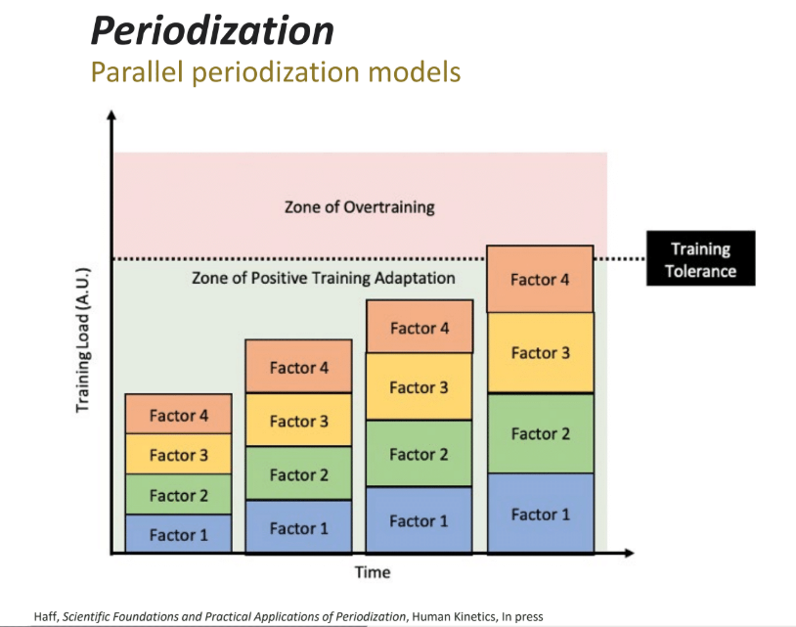
STEP 6 · PERIODIZATION MODELS
06
PLAN THE WORK. WORK THE PLAN.
NEBRASKA STRENGTH & CONDITIONING / NSAA OFFICIAL PARTNER / NEBRASKASC.COM
79

Slide 80
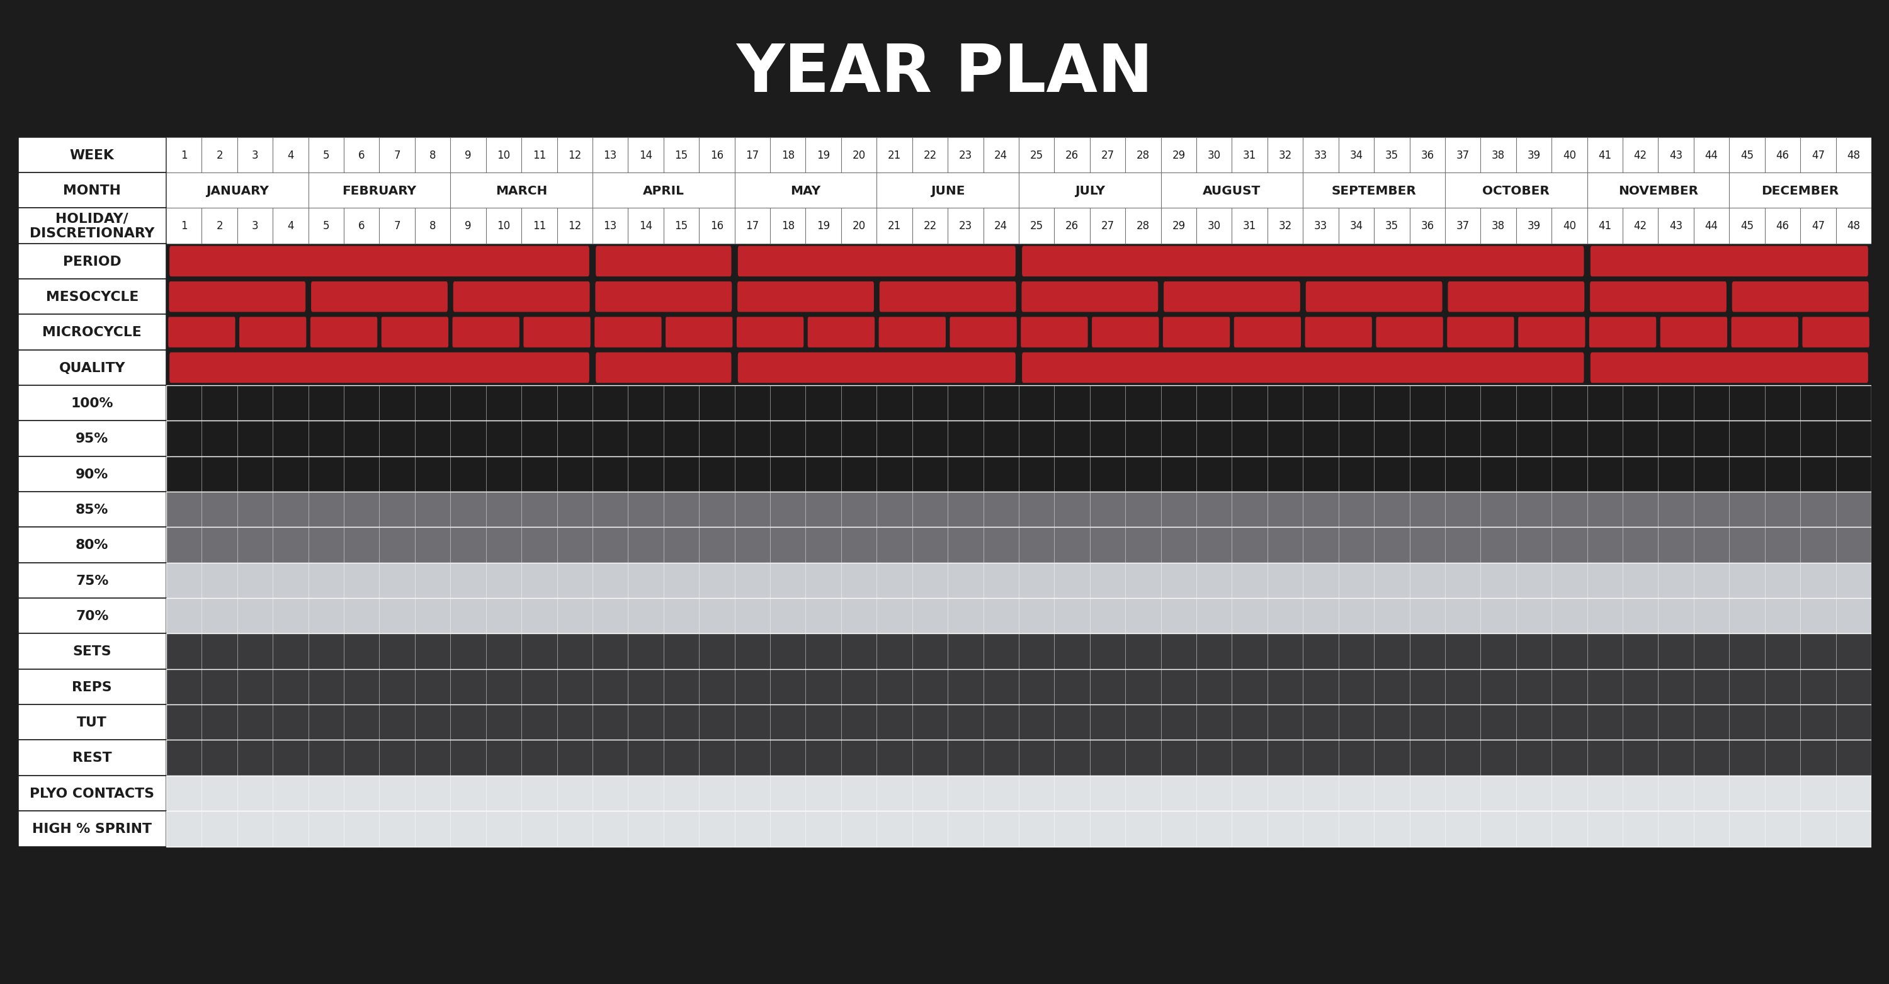
NEBRASKA STRENGTH & CONDITIONING / NSAA OFFICIAL PARTNER / NEBRASKASC.COM
80

Slide 81
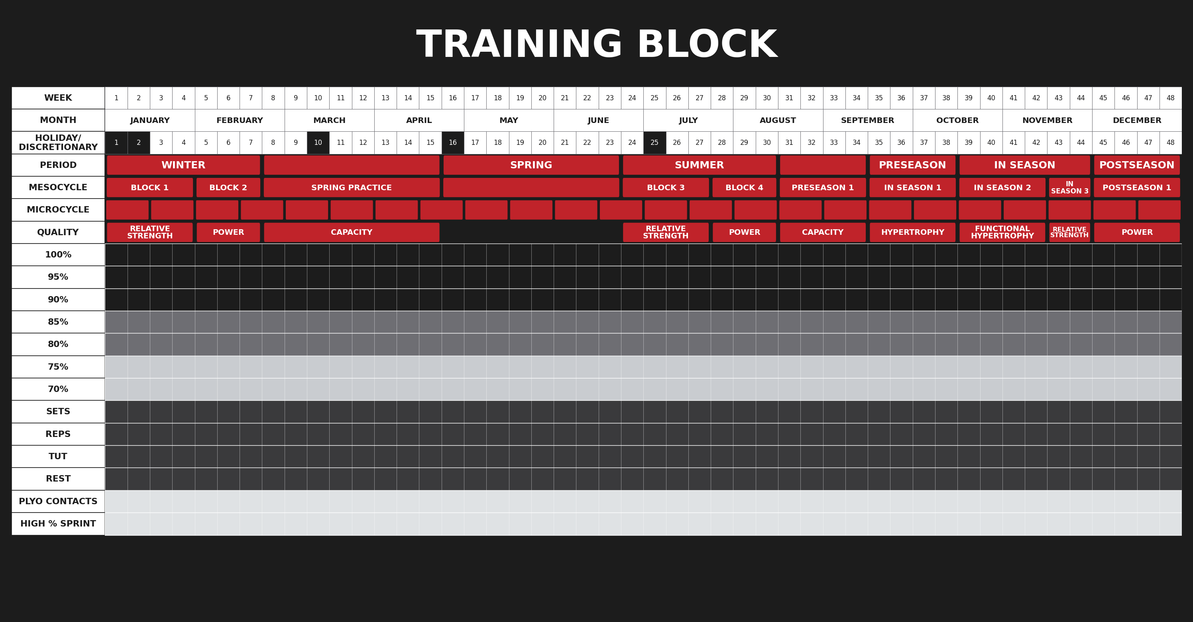
NEBRASKA STRENGTH & CONDITIONING / NSAA OFFICIAL PARTNER / NEBRASKASC.COM
81

Slide 82
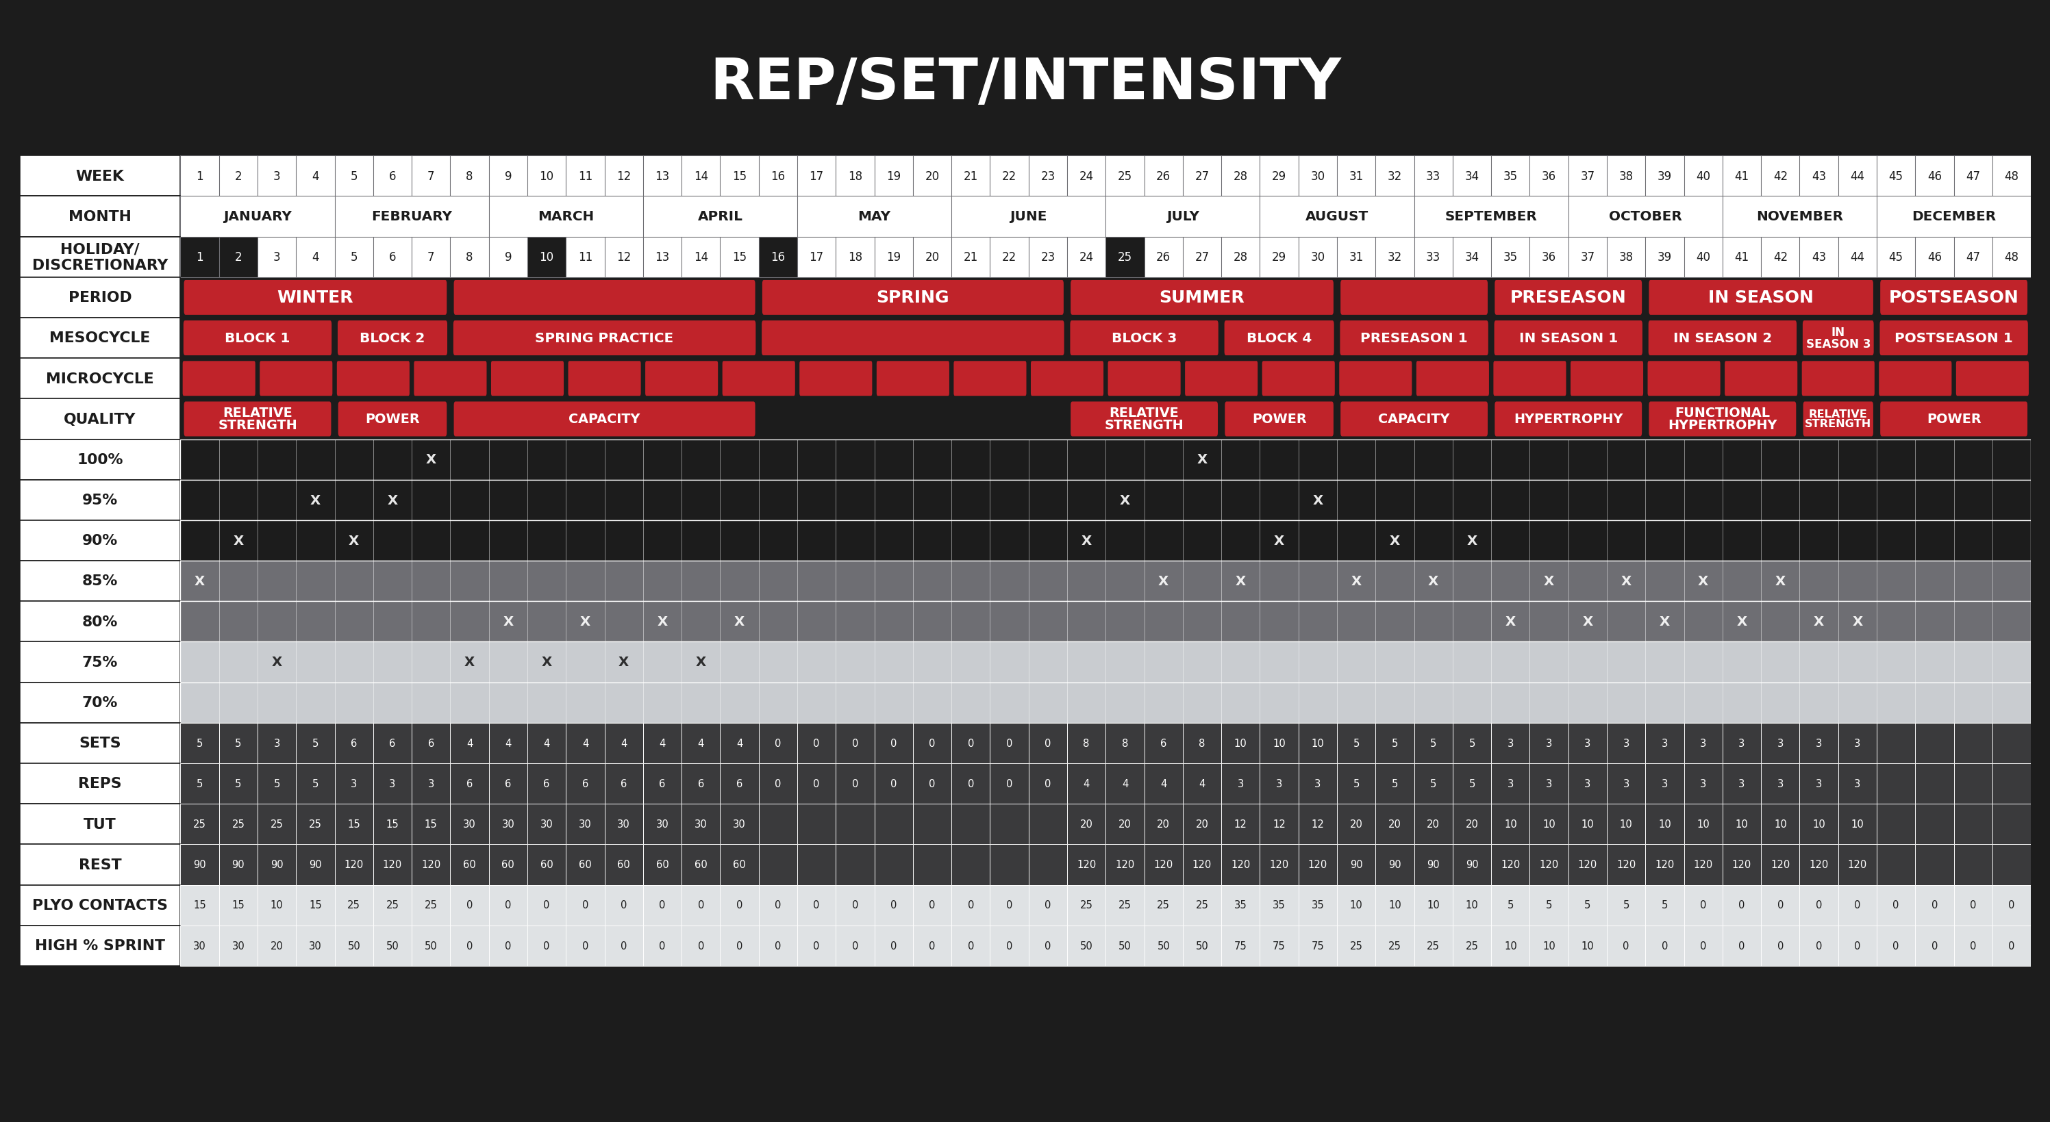
NEBRASKA STRENGTH & CONDITIONING / NSAA OFFICIAL PARTNER / NEBRASKASC.COM
82

Slide 83
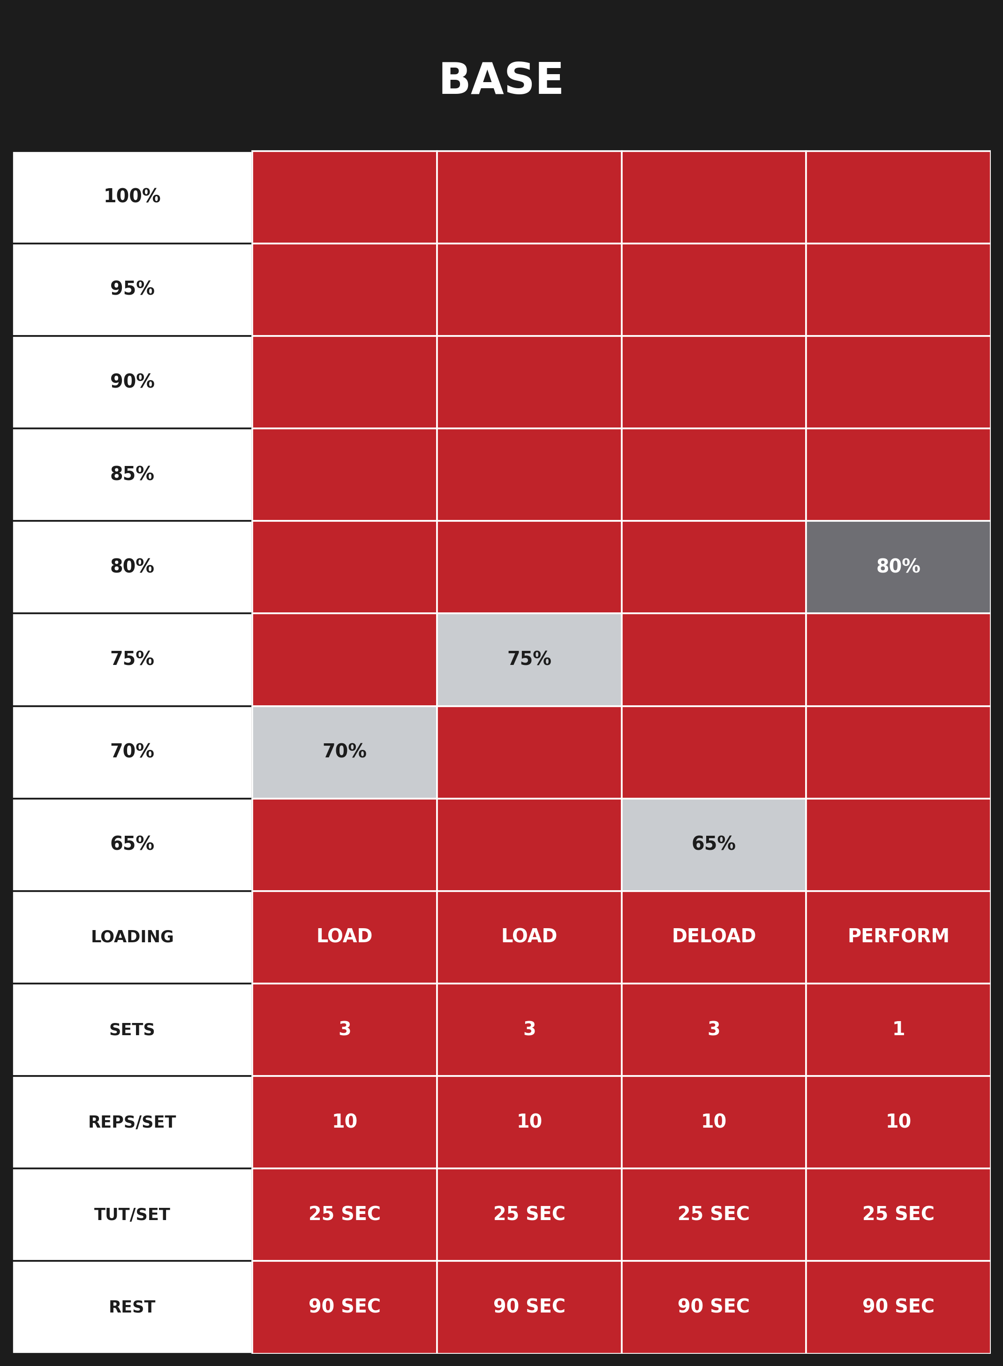
NEBRASKA STRENGTH & CONDITIONING / NSAA OFFICIAL PARTNER / NEBRASKASC.COM
83

Slide 84
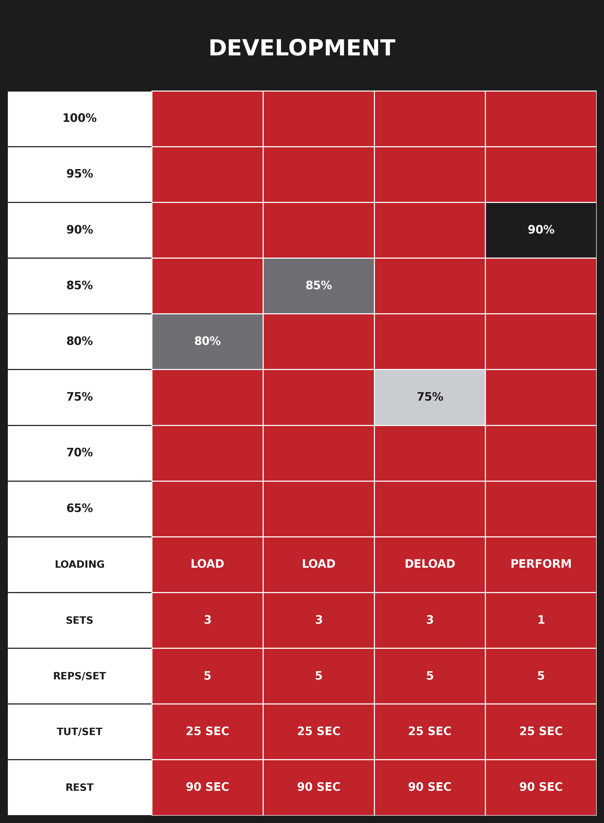
NEBRASKA STRENGTH & CONDITIONING / NSAA OFFICIAL PARTNER / NEBRASKASC.COM
84

Slide 85
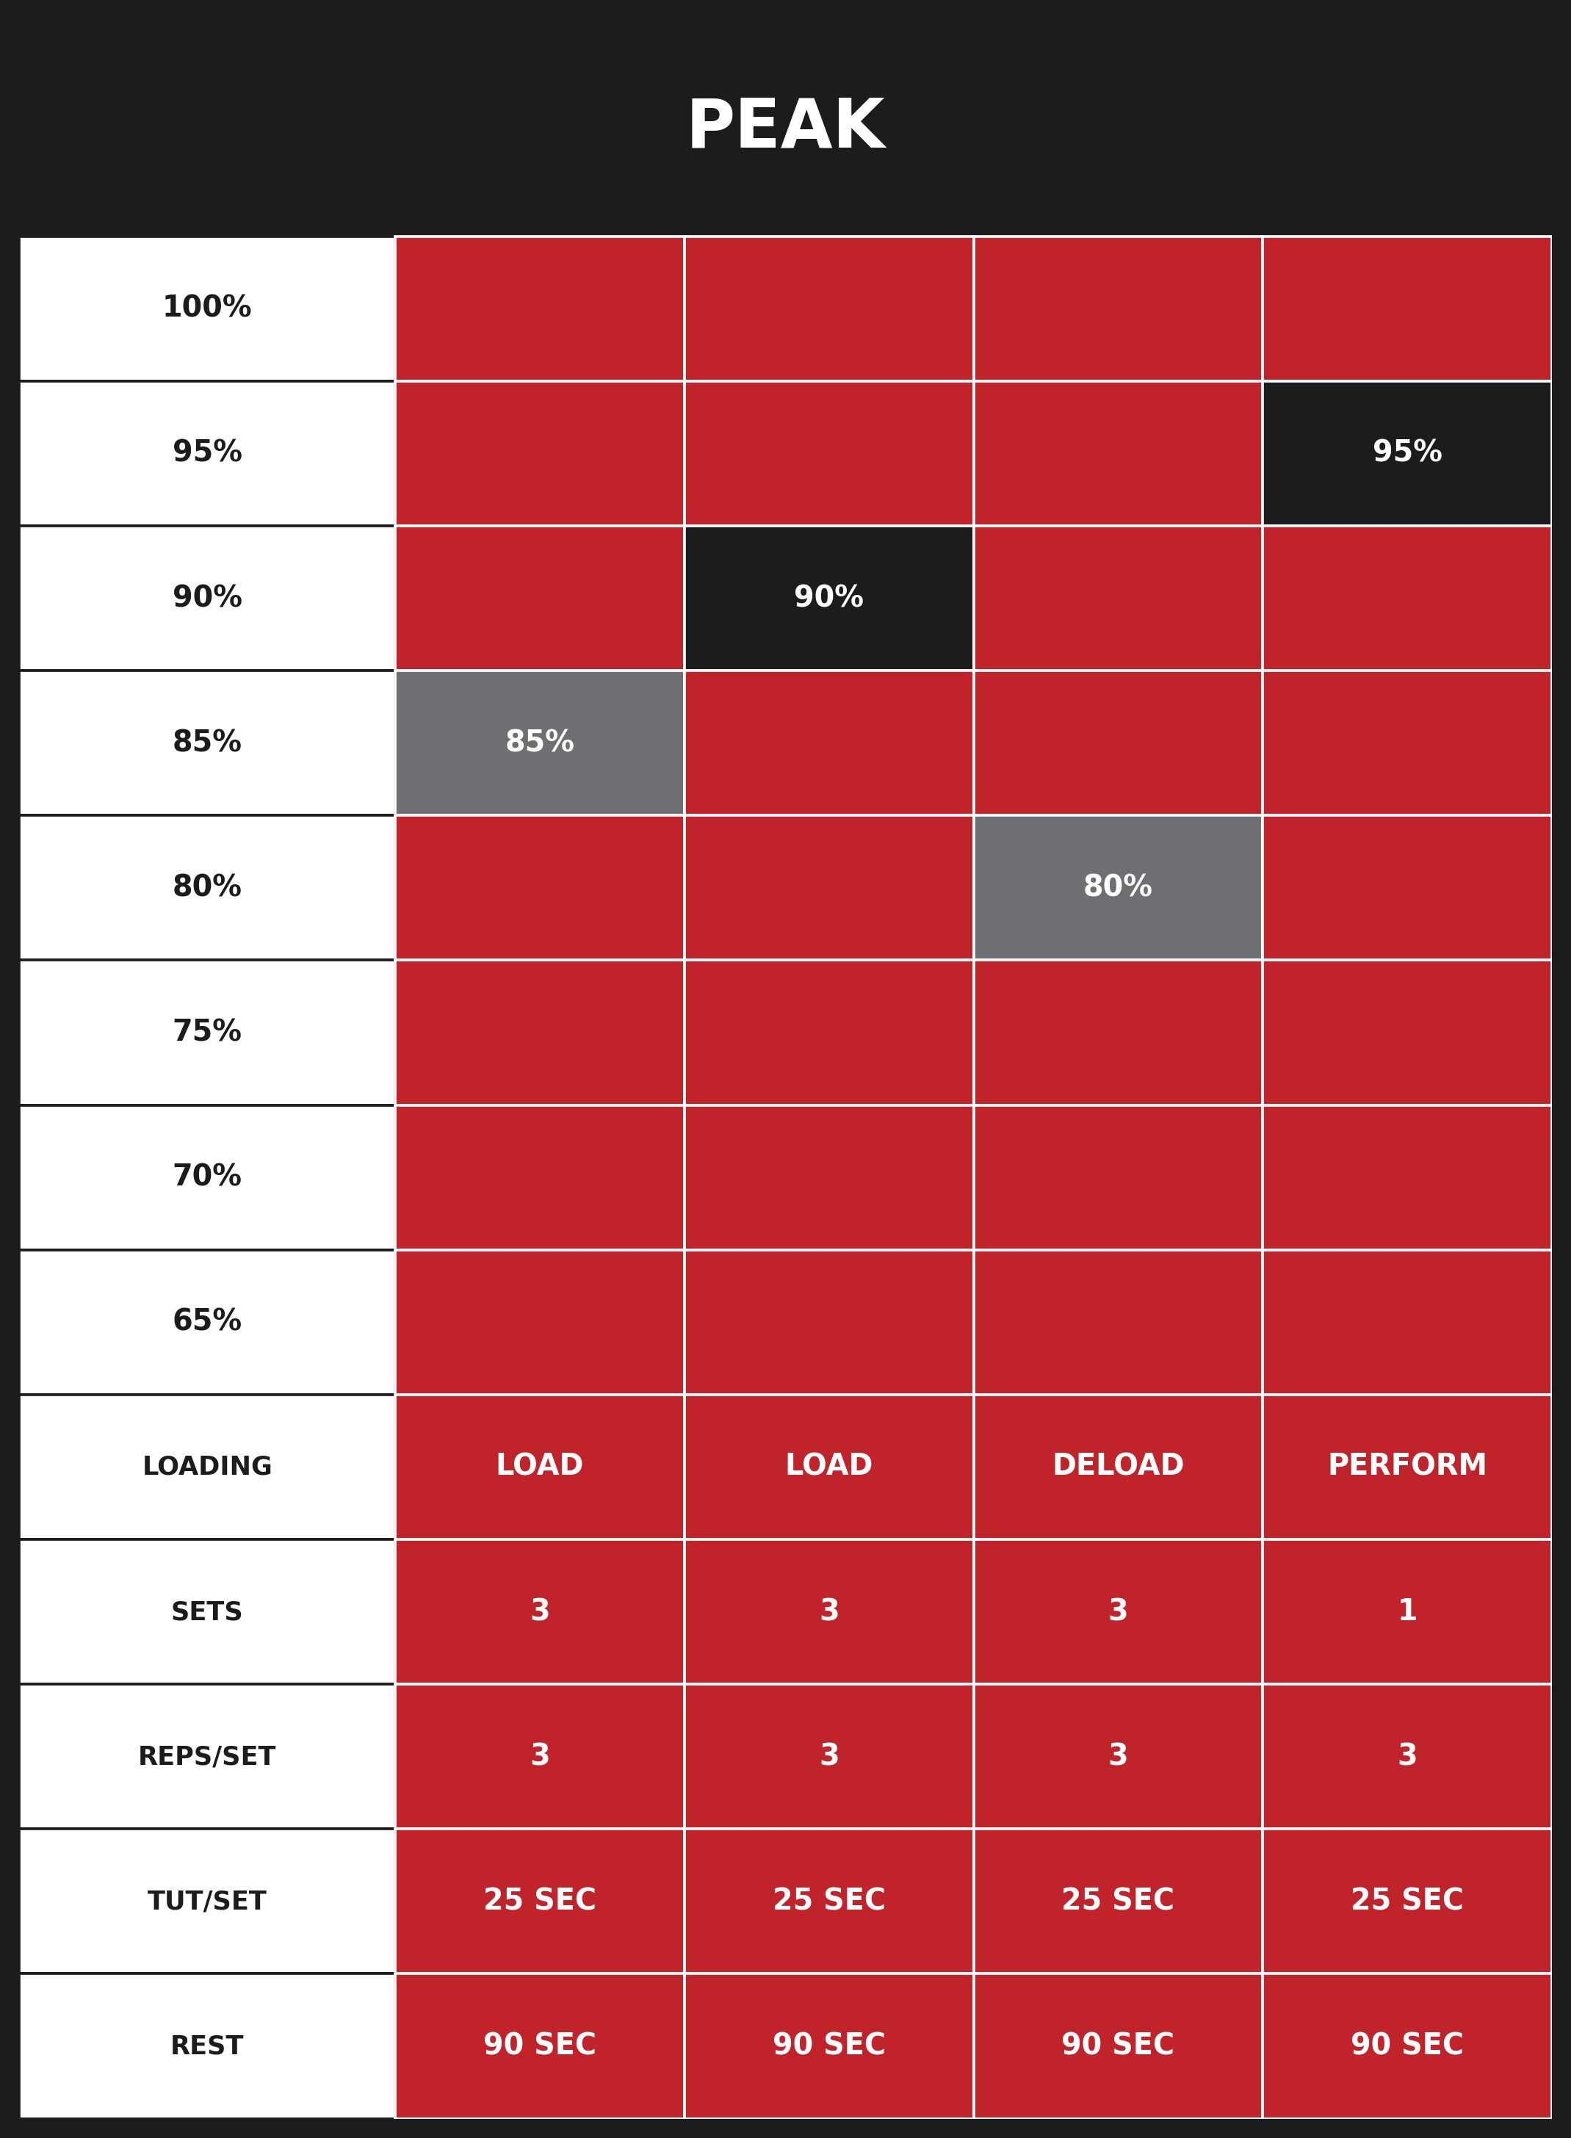
NEBRASKA STRENGTH & CONDITIONING / NSAA OFFICIAL PARTNER / NEBRASKASC.COM
85

Slide 86
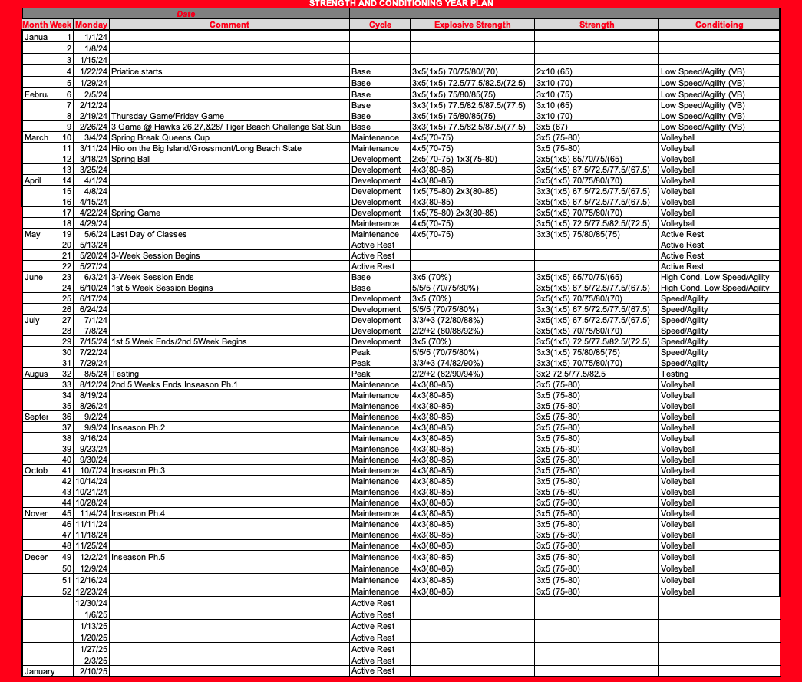
PROGRAMMING · THE YEAR PLAN
06
A FULL TRAINING YEAR ON ONE PAGE
NEBRASKA STRENGTH & CONDITIONING / NSAA OFFICIAL PARTNER / NEBRASKASC.COM
86

Slide 87
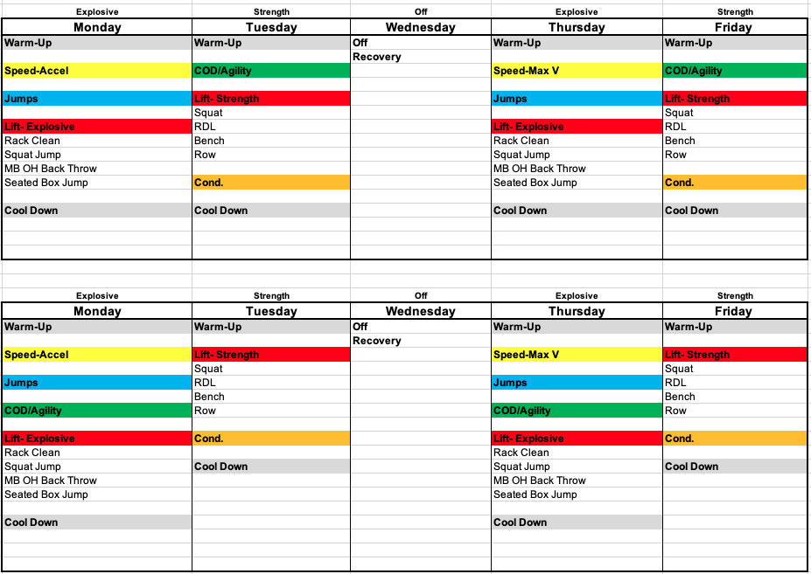
PROGRAMMING · WEEKLY OUTLINE 1 OF 4
06
SAMPLE TRAINING WEEKS
NEBRASKA STRENGTH & CONDITIONING / NSAA OFFICIAL PARTNER / NEBRASKASC.COM
87

Slide 88
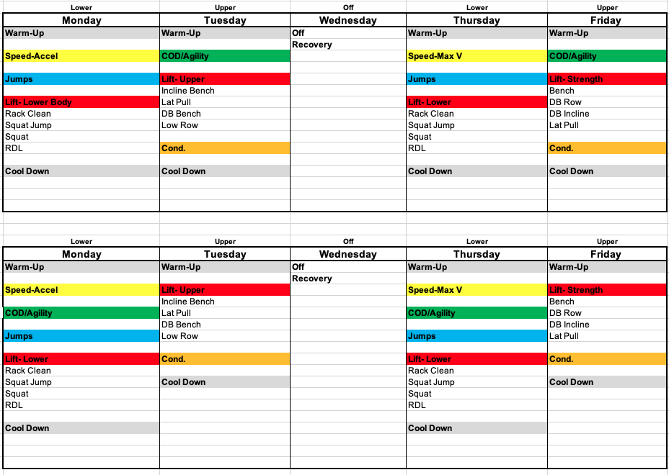
PROGRAMMING · WEEKLY OUTLINE 2 OF 4
06
SAMPLE TRAINING WEEKS
NEBRASKA STRENGTH & CONDITIONING / NSAA OFFICIAL PARTNER / NEBRASKASC.COM
88

Slide 89
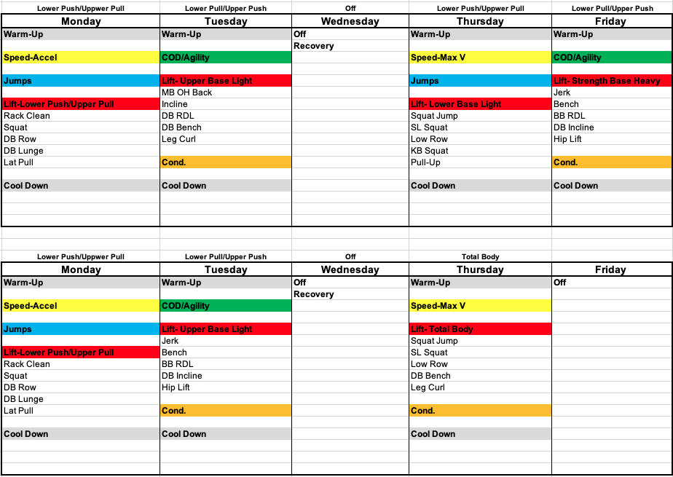
PROGRAMMING · WEEKLY OUTLINE 3 OF 4
06
SAMPLE TRAINING WEEKS
NEBRASKA STRENGTH & CONDITIONING / NSAA OFFICIAL PARTNER / NEBRASKASC.COM
89

Slide 90
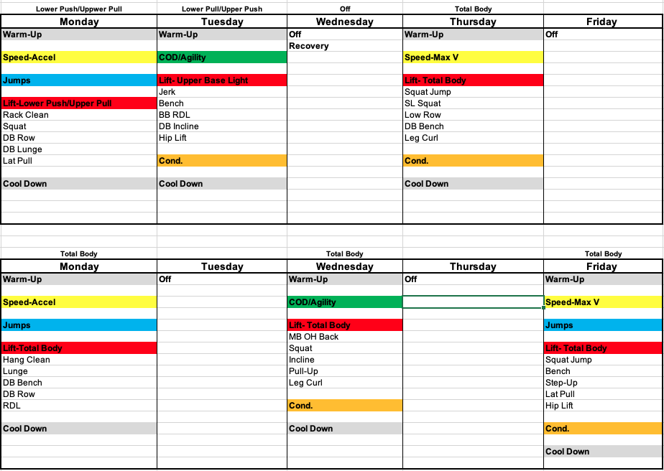
PROGRAMMING · WEEKLY OUTLINE 4 OF 4
06
SAMPLE TRAINING WEEKS
NEBRASKA STRENGTH & CONDITIONING / NSAA OFFICIAL PARTNER / NEBRASKASC.COM
90

Slide 91
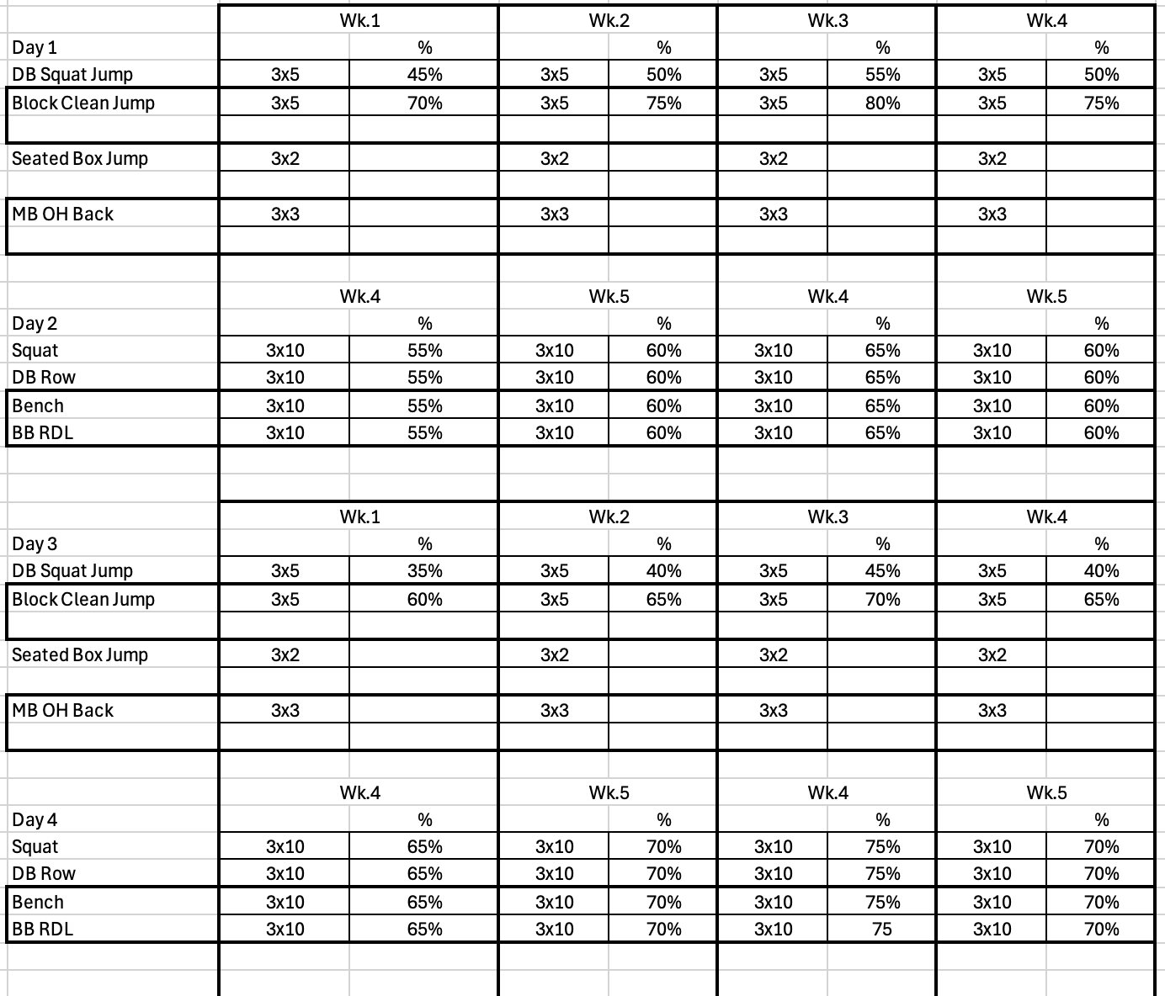
SAMPLE PROGRAM · PHASE 1
06
BASE
NEBRASKA STRENGTH & CONDITIONING / NSAA OFFICIAL PARTNER / NEBRASKASC.COM
91

Slide 92
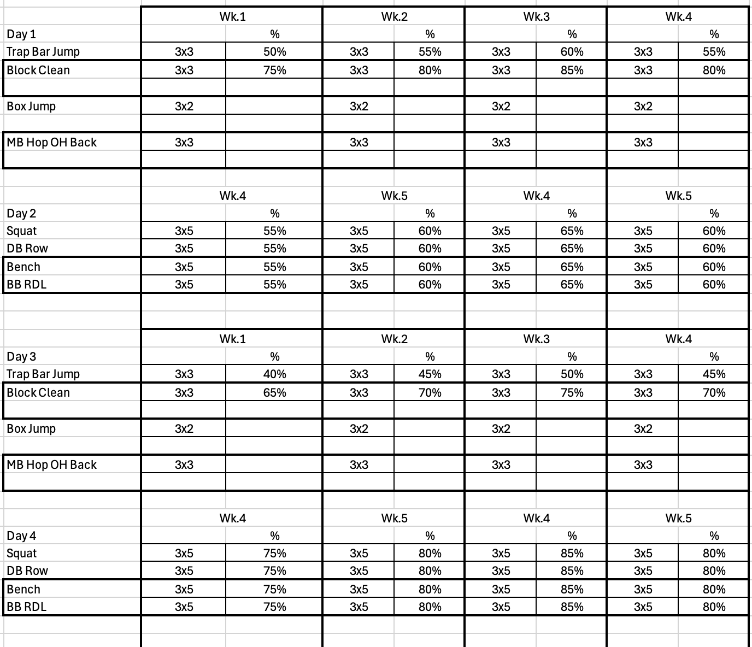
SAMPLE PROGRAM · PHASE 2
06
DEVELOPMENT
NEBRASKA STRENGTH & CONDITIONING / NSAA OFFICIAL PARTNER / NEBRASKASC.COM
92

Slide 93
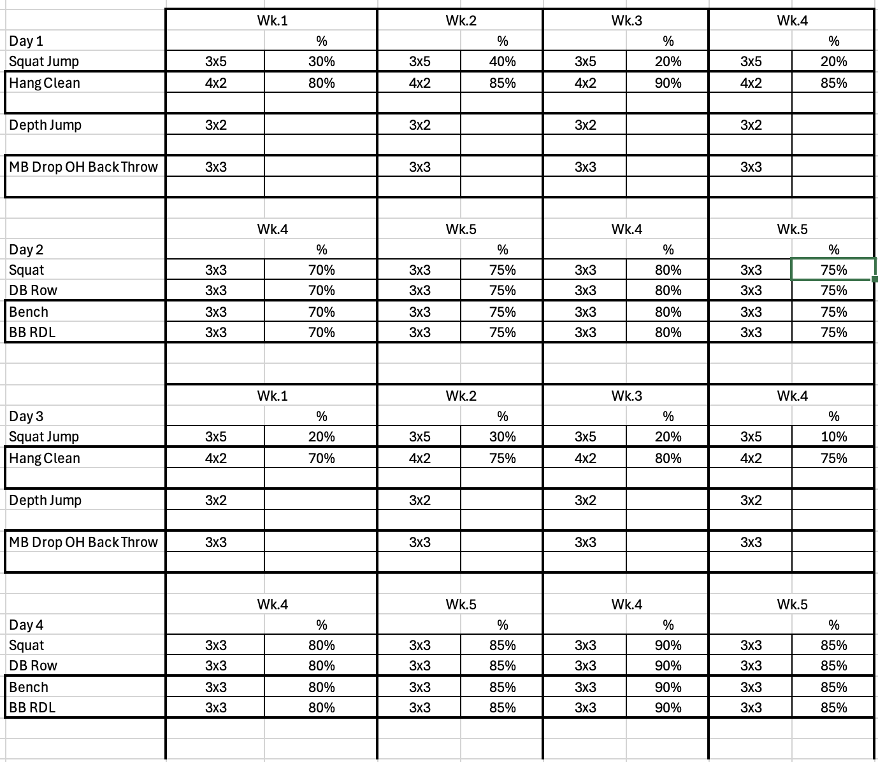
SAMPLE PROGRAM · PHASE 3
06
PEAK
NEBRASKA STRENGTH & CONDITIONING / NSAA OFFICIAL PARTNER / NEBRASKASC.COM
93

Slide 94
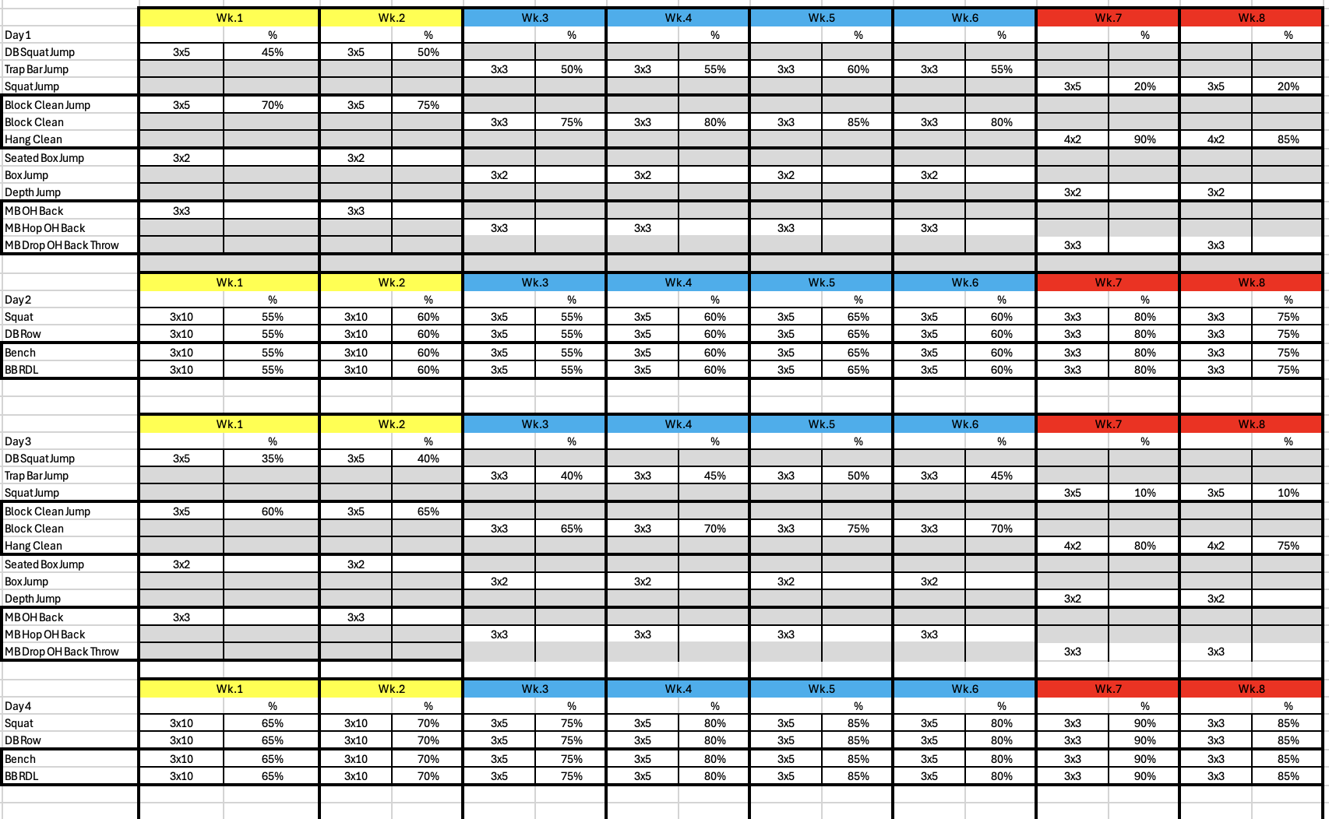
SAMPLE PROGRAM · FULL BLOCK
06
THE 8-WEEK PLAN
NEBRASKA STRENGTH & CONDITIONING / NSAA OFFICIAL PARTNER / NEBRASKASC.COM
94

Slide 95
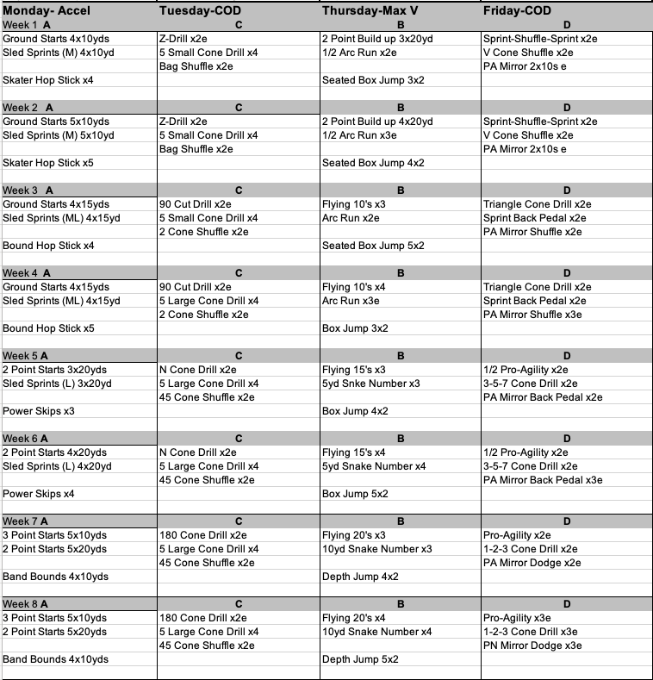
SAMPLE PROGRAM · SPEED & COD
06
SPEED & CHANGE OF DIRECTION
NEBRASKA STRENGTH & CONDITIONING / NSAA OFFICIAL PARTNER / NEBRASKASC.COM
95

Slide 96
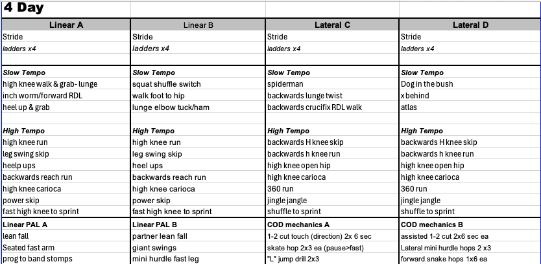
4-Day Warm-Up
Principles of Training Athletes
96
Notes:
The 4-day warm-up template splits into Linear A/B and Lateral C/D tracks.

Slide 97
Sample 4-Day Program
Principles of Training Athletes
97
Notes:
An 8-week sample 4-day speed/COD program.

Slide 98
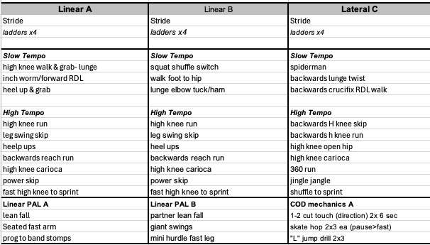
3-Day Warm-Up
Principles of Training Athletes
98
Notes:
The 3-day warm-up template condenses to Linear A/B and Lateral C.

Slide 99
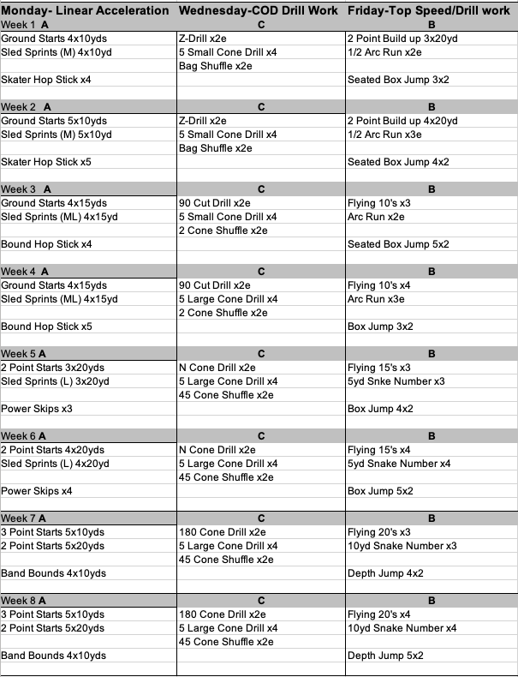
Sample 3-Day Program
Principles of Training Athletes
99
Notes:
An 8-week sample 3-day speed/COD program.

Slide 100
THE OTHER HALF OF THE PROGRAM
YOU CAN'T OUT-TRAIN POOR RECOVERY
The best program is only as good as the recovery around it. Two levers move the needle most for high school athletes: nutrition and sleep.
100

Slide 101




RECOVERY · NUTRITION
07
NUTRITION: FUEL THE WORK AND THE GROWTH
Keep it simple and habit-based — teenagers don't need macros, they need consistent basics.
PROTEIN EVERY MEAL
CARBS AROUND TRAINING
HYDRATE ALL DAY
EAT ENOUGH, EAT REAL
Supports the muscle your training is trying to build. Spread it across the day.
The main fuel for hard sessions and games — don't fear them, time them.
Even mild dehydration drops performance. Start before practice, not during.
Growing athletes under-fuel constantly. Whole foods first, supplements last.
Your role isn't to be a dietitian — it's to set the standard and make the easy choice the default.
NEBRASKA STRENGTH & CONDITIONING / NSAA OFFICIAL PARTNER / NEBRASKASC.COM
101

Slide 102
NUTRITION · PROTEIN
07
PROTEIN: THE BUILDING SIGNAL
Training is the stimulus — protein is both the raw material and the switch that turns building on.
20–40g
PER MEAL, 3–4× A DAY
the dose range that maximally stimulates muscle protein synthesis in young athletes
THE MECHANISM
Lifting elevates muscle protein synthesis for 24–48 hours. Each protein feeding — driven by ~2–3 g of the amino acid leucine — switches building on again.
01
THE DAILY TARGET
1.4–2.0 g per kg bodyweight per day for training athletes. For a 150 lb athlete, that’s roughly 95–135 g spread across the day.
02
DISTRIBUTION BEATS TOTALS
Four even doses out-build one giant dinner. Most teens eat almost no protein at breakfast and most of it at night — backwards for growth.
03
THE OVERNIGHT WINDOW
30–40 g of slow-digesting protein before bed — milk, Greek yogurt, cottage cheese — feeds 8+ hours of overnight repair.
04
Sources: ISSN Position Stand on protein & exercise; Moore et al.; Res & van Loon pre-sleep protein research
NEBRASKA STRENGTH & CONDITIONING / NSAA OFFICIAL PARTNER / NEBRASKASC.COM
102

Slide 103
NUTRITION · CARBOHYDRATE
07
CARBOHYDRATE: THE PERFORMANCE FUEL
Muscle glycogen is the tank for sprints, reps, and fourth quarters. Low tank = slow legs, sloppy technique, late-game injuries.
3–4 H BEFORE
THE MEAL
0–60 MIN BEFORE
THE TOP-UP
DURING
LONG EVENTS
0–60 MIN AFTER
THE REFILL
The main fill of the tank: 1–4 g/kg of carbs from rice, pasta, potatoes, or oats, plus protein and fluids.
Small, familiar, fast-digesting: banana, granola bar, sports drink. Nothing new on game day — ever.
When games or tournaments run past ~60–90 minutes: 30–60 g of carbs per hour from drinks or fruit.
Glycogen restocks fastest right after: ~1–1.2 g/kg per hour, paired with protein. Chocolate milk earns its reputation.
Daily range: 3–8 g/kg, scaled to training load — a two-a-day week sits at the top, a rest day near the bottom.
Sources: ISSN and ACSM / Academy of Nutrition & Dietetics joint position stands on nutrition and athletic performance
NEBRASKA STRENGTH & CONDITIONING / NSAA OFFICIAL PARTNER / NEBRASKASC.COM
103

Slide 104
NUTRITION · HYDRATION
07
HYDRATION: SMALL DEFICITS, REAL COSTS
Performance drops before thirst gets loud — make fluid a protocol, not a feeling.
−2%
BODYWEIGHT IN SWEAT
the loss at which speed, skill, and decision-making measurably decline
SWEAT RATES VARY WILDLY
0.5–2.0 L per hour between athletes in the same practice. Pre/post weigh-ins beat guessing: 1 lb lost ≈ 16 oz of sweat.
01
THE BRAIN GOES FIRST
Mild dehydration impairs reaction time, focus, and skill execution before endurance ever suffers — the QB misreads before the lineman tires.
02
ELECTROLYTES EARN THEIR PLACE
Salty sweaters, August heat, and two-a-days need sodium — roughly 300–600 mg per hour — not just water.
03
MONITOR THE EASY WAY
Morning urine should be pale straw. Bottle at every session, drink to a schedule in heat, and replace 16–24 oz per pound lost.
04
Sources: ACSM Position Stand on Exercise & Fluid Replacement; NATA fluid replacement guidelines
NEBRASKA STRENGTH & CONDITIONING / NSAA OFFICIAL PARTNER / NEBRASKASC.COM
104

Slide 105
NUTRITION · ENERGY AVAILABILITY
07
EAT ENOUGH: THE FOUNDATION UNDER IT ALL
A growing athlete pays two energy bills — growth and training. Underpay either, and performance collapses quietly.
RED-S
RELATIVE ENERGY DEFICIENCY IN SPORT
what chronic under-fueling becomes — in boys and girls alike
THE DOUBLE ENERGY BILL
A growth spurt plus a sport can push needs past 3,000–4,000 kcal per day. Appetite alone often won’t get a busy teen there.
01
WHAT UNDER-FUELING BREAKS
Bone density, hormones, immunity, mood — and every adaptation you’re training for. Stalled lifts are usually the first visible sign.
02
THE INJURY CONNECTION
Low energy availability is linked to stress fractures and recurring soft-tissue injury. The weight room cannot out-lift an energy hole.
03
FOOD FIRST, ALWAYS
No powder fixes an under-fueled athlete. Whole foods, bigger portions, planned snacks — supplements only on top of full plates.
04
Source: IOC Consensus Statement on Relative Energy Deficiency in Sport (RED-S)
NEBRASKA STRENGTH & CONDITIONING / NSAA OFFICIAL PARTNER / NEBRASKASC.COM
105

Slide 106
NUTRITION · RECAP
07
PUT NUMBERS BEHIND THE BASICS
Rules of thumb, not prescriptions — enough to set standards without becoming the team dietitian.
THE NUMBERS
TEAM STANDARDS YOU CAN SET
Protein: 20–40 g per meal — a palm-sized portion, 3–4× a day
Carbs: refuel within ~60 min of hard sessions and games
Fluids: half your bodyweight (lb) in oz daily, plus 16–24 oz per lb lost at practice
Post-lift snack within 30 min — chocolate milk or a PB sandwich works
Breakfast is non-negotiable on training and game days
Travel rule: every athlete packs real food — sandwich, fruit, fluids
RED FLAGS
SEND IT HOME
In-season weight loss, stalled lifts, constant fatigue — classic under-fueling
Energy drinks as “pre-workout”
Rapid weight cutting or skipped meals — refer out; don’t coach it alone
Give parents a grocery staples list — eggs, milk, yogurt, rice, fruit
Food first, supplements last — nothing in a tub replaces meals
Frame it as performance fuel, never as dieting
NEBRASKA STRENGTH & CONDITIONING / NSAA OFFICIAL PARTNER / NEBRASKASC.COM
106

Slide 107




RECOVERY · SLEEP
07
SLEEP: THE MOST UNDERRATED TRAINING TOOL
WHERE ADAPTATION HAPPENS
Growth hormone peaks in deep sleep — the gains are built overnight.
8–10
SKILL & DECISION-MAKING
Sleep consolidates motor learning and sharpens reaction time.
HOURS PER NIGHT
recommended for teen athletes
INJURY & ILLNESS DEFENSE
Under 8 hours is linked to markedly higher injury rates in youth athletes.
PROTECT THE ROUTINE
Consistent bed/wake times, screens down early, dark and cool room.
NEBRASKA STRENGTH & CONDITIONING / NSAA OFFICIAL PARTNER / NEBRASKASC.COM
107

Slide 108
SLEEP · THE SCIENCE
07
WHAT A NIGHT OF SLEEP ACTUALLY DOES
Sleep isn’t downtime — it’s scheduled construction, and every stage has a different job.
~90-MIN CYCLES
THE STRUCTURE
DEEP SLEEP
THE BODY SHOP
REM SLEEP
THE SKILL LAB
THE SHORT-NIGHT TAX
WHY 6 ≠ 8
The night runs in 4–6 cycles through light, deep, and REM sleep. Architecture matters as much as total hours.
Growth hormone pulses peak here — muscle repair, bone growth, immune function. Concentrated early in the night.
Consolidates motor learning and sharpens decision-making — the plays you drilled get written to memory. Concentrated in the morning cycles.
Cutting the last hour doesn’t trim evenly — it amputates REM, the exact stage skill athletes need most.
A 6-hour night isn’t 75% of an 8-hour night — the hours you lose are the most skill-dense ones.
Sleep stage physiology per American Academy of Sleep Medicine reference standards
NEBRASKA STRENGTH & CONDITIONING / NSAA OFFICIAL PARTNER / NEBRASKASC.COM
108

Slide 109
SLEEP · THE EVIDENCE
07
WHAT THE DATA SAYS ABOUT SLEEP AND SPORT
Three numbers worth repeating to your athletes — all from peer-reviewed research.
+9%
SHOOTING ACCURACY
Stanford basketball players who extended sleep toward 10 h improved free-throw and 3-point accuracy ~9% — and sprinted faster.
1.7×
INJURY RISK
Adolescent athletes sleeping under 8 hours were ~1.7× more likely to get injured than teammates sleeping more.
4.2×
ILLNESS RISK
Adults sleeping under 6 hours were 4.2× more likely to catch a cold after controlled virus exposure.
And after ~17–19 hours awake, reaction time resembles a ~0.05 blood-alcohol level. Nobody would let an athlete compete like that.
Sources: Mah et al. 2011; Milewski et al. 2014; Prather et al. 2015; Williamson & Feyer 2000
NEBRASKA STRENGTH & CONDITIONING / NSAA OFFICIAL PARTNER / NEBRASKASC.COM
109

Slide 110
SLEEP · THE TEENAGE CLOCK
07
YOUR ATHLETES ARE FIGHTING THEIR BIOLOGY
Teens aren’t lazy at 6:45 am — their clock is shifted. Coach around the biology instead of against it.
~2h
CIRCADIAN PHASE DELAY
puberty pushes melatonin release — and natural sleep time — later
THE BIOLOGY
Adolescent melatonin onset drifts toward 10–11 pm while school still starts early. The squeeze is structural, not a character flaw.
01
SCREENS MAKE IT WORSE
Bright evening light suppresses melatonin and delays the clock further — the last hour of scrolling costs more than an hour of sleep.
02
CAFFEINE’S LONG TAIL
Half-life of 5–6 hours: half of a 3 pm energy drink is still circulating at bedtime, cutting into deep sleep even if they nod off.
03
WHAT ACTUALLY HELPS
Morning light, a consistent wake time (weekends too), 20–30 min naps before 3 pm, and scheduling the hardest sessions earlier.
04
Sources: Carskadon et al., adolescent circadian research; AAP policy statement on school start times
NEBRASKA STRENGTH & CONDITIONING / NSAA OFFICIAL PARTNER / NEBRASKASC.COM
110

Slide 111
SLEEP · RECAP
07
MAKE 8–10 HOURS ACTUALLY HAPPEN
Teenagers won’t choose sleep — routines and defaults choose it for them.
THE NUMBERS
TEAM STANDARDS YOU CAN SET
8–10 hours per night for ages 13–18
Under 8 hours ≈ 1.7× higher injury risk in adolescent athletes
Bed & wake within ~1 hour — weekends included
Naps: 20–30 minutes, before 3 pm
Caffeine cutoff 6+ hours before bed — no energy drinks after school
Screens down 30–60 minutes before lights-out
Ask about sleep in check-ins the way you ask about soreness
RED FLAGS
SEND IT HOME
Weekend binge sleeping — 2+ hour shifts are social jet lag
Nodding off in film sessions or class
Needing caffeine to get through practice
Dark, cool room (65–68 °F) — beats any recovery gadget
Phones charge outside the bedroom overnight
Consistent household lights-out — parents back the standard
NEBRASKA STRENGTH & CONDITIONING / NSAA OFFICIAL PARTNER / NEBRASKASC.COM
111

Slide 112



PUTTING IT TOGETHER
07
IT ALL CONNECTS IN ONE LOOP
ANALYZE
DEFINE
PERIODIZE
TRAIN
RETEST
needs
KPIs & goals
the plan
+ recover
& adjust
...and back to the start.
NEBRASKA STRENGTH & CONDITIONING / NSAA OFFICIAL PARTNER / NEBRASKASC.COM
112

Slide 113
WALK AWAY WITH THIS
FIVE THINGS TO DO MONDAY
1
Run a needs analysis for your main sport — demands vs. athlete.
2
Pick 3–5 KPIs you can measure with what you already own.
3
Lock a standardized testing protocol and a place to record it.
4
Sketch your training year backward from competition dates.
5
Set one team nutrition standard and one sleep standard.
113

Slide 114



THANK YOU
Questions — and let's talk programming.
WANT A PROGRAM BUILT FOR YOUR SCHOOL?
We'll have a straight-up conversation about fit — no pressure, no canned pitch.
nebraskasc.com
nebraskasc.com/contact
NSAA Official Partner
NEBRASKA STRENGTH & CONDITIONING / NSAA OFFICIAL PARTNER / NEBRASKASC.COM
114

Slide 115
Thank you.
Contact bkmitta@huskers.com
Principles of Training Athletes
115
Notes:
Closing slide.

